Slide 1
Intensive Hemodialysis and Potential Risks with Increasing Treatment
Kraus MA, Kansal S, Copland M, Komenda P, Weinhandl ED, Bakris GL, Chan CT, Fluck RJ, Burkhart JM. Intensive Hemodialysis and Potential Risks with Increasing Treatment. American Journal of Kidney Diseases, Volume 68, Issue 5, S51 - S58.
AdvancingDialysis.org

Slide 2
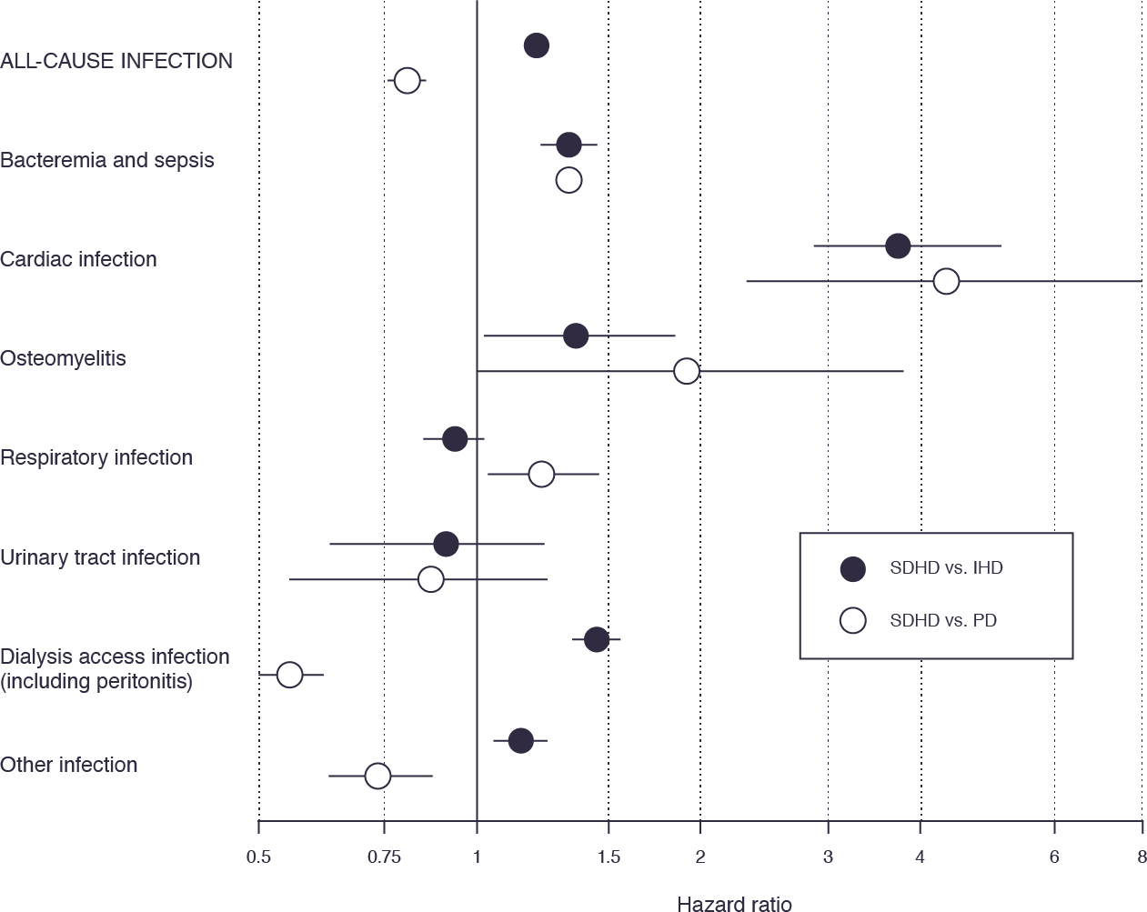
Infection appears to be more likely with intensive hemodialysis, although the relative importance of frequency versus setting (in-center versus home) merits further investigation.^{1,2,3,4,5}
Chapter 6, Figure 1:⁶ Relative hazards of cause-specific
infection-related hospitalization for short daily hemodialysis versus conventional in-center hemodialysis¹ and versus peritoneal dialysis.²
Solid lines represent 95% confidence intervals around estimated hazard ratios (solid dots).Abbreviations: CIHD, in-center hemodialysis; PD, peritoneal dialysis; SDHD, short daily hemodialysis.
¹Weinhandl ED, Nieman KM, Gilbertson DT, Collins AJ. Hospitalization in daily home hemodialysis and matched thrice-weekly in-center hemodialysis patients. Am J Kidney Dis Off J Natl Kidney Found. 2015;65(1):98-108. doi:10.1053/j.ajkd.2014.06.015. ²Weinhandl ED, Gilbertson DT, Collins AJ. Mortality, Hospitalization, and Technique Failure in Daily Home Hemodialysis and Matched Peritoneal Dialysis Patients: A Matched Cohort Study. Am J Kidney Dis Off J Natl Kidney Found. 2016;67(1):98-110. doi:10.1053/j.ajkd.2015.07.014. ³FHN Trial Group, Chertow GM, Levin NW, et al. In-center hemodialysis six times per week versus three times per week. N Engl J Med. 2010;363(24):2287-2300. doi:10.1056/NEJMoa1001593. ⁴Rocco MV, Lockridge RS, Beck GJ, et al. The effects of frequent nocturnal home hemodialysis: the Frequent Hemodialysis Network Nocturnal Trial. Kidney Int. 2011;80(10):1080-1091. doi:10.1038/ki.2011.213. ⁵Spry LA, Burkart JM, Holcroft C, Mortier L, Glickman JD. Survey of home hemodialysis patients and nursing staff regarding vascular access use and care. Hemodial Int Int Symp Home Hemodial. 2015;19(2):225-234. doi:10.1111/hdi.12211. ⁶Kraus, M.A., Kansal, S., Copland, M. et al, Intensive hemodialysis and potential risks with increasing treatment. Am J Kidney Dis. 2016;68:S51–S58.
AdvancingDialysis.org

