Slide 1
Intensive Hemodialysis, Treatment Complications and Tolerability
Morfin JA, Fluck RJ, Weinhandl ED, Kansal S, McCullough PA, Komenda P. Intensive Hemodialysis and Treatment Complications and Tolerability. American Journal of Kidney Diseases, Volume 68, Issue 5, S43 - S50.
AdvancingDialysis.org

Slide 2
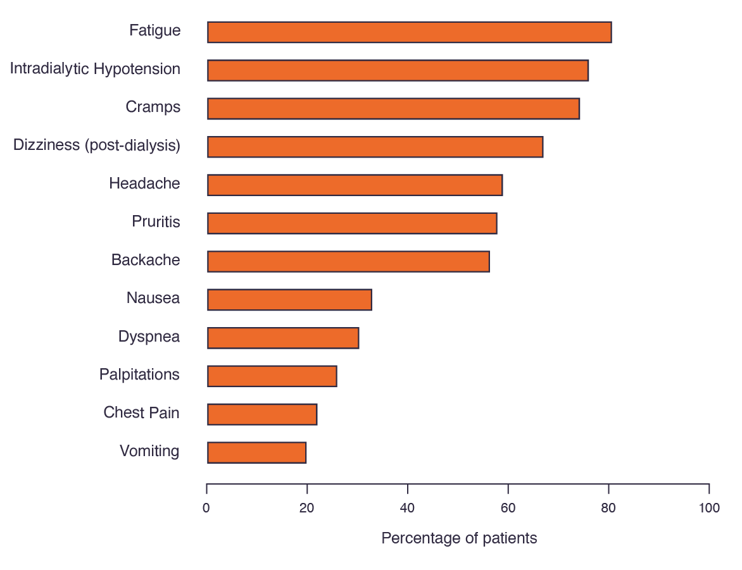
Many of the most commonly reported symptoms among hemodialysis patients and care partners were identified as being more important than life expectancy.^{1,2}
Symptoms identified as more important included fatigue, drops in blood pressure, and cramping.
Chapter 5, Figure 1:³ Prevalence of commonly reported symptoms in a cohort of 550 hemodialysis patients.²
¹Caplin B, Kumar S, Davenport A. Patients’ perspective of haemodialysis-associated symptoms. Nephrol Dial Transplant Off Publ Eur Dial Transpl Assoc - Eur Ren Assoc. 2011;26(8):2656-2663. doi:10.1093/ndt/gfq763.
²Urquhart-Secord R, Craig JC, Hemmelgarn B, et al. Patient and Caregiver Priorities for Outcomes in Hemodialysis: An International Nominal Group Technique Study. Am J Kidney Dis Off J Natl Kidney Found. March 2016. doi:10.1053/j.ajkd.2016.02.037.
³Morfin, J.A., Fluck, R.J., Weinhandl, E.D., Kansal, S., McCullough, P.A., Komenda, P. Intensive hemodialysis and treatment complications and tolerability. Am J Kidney Dis. 2016;68:S43–S50.
AdvancingDialysis.org

Slide 3
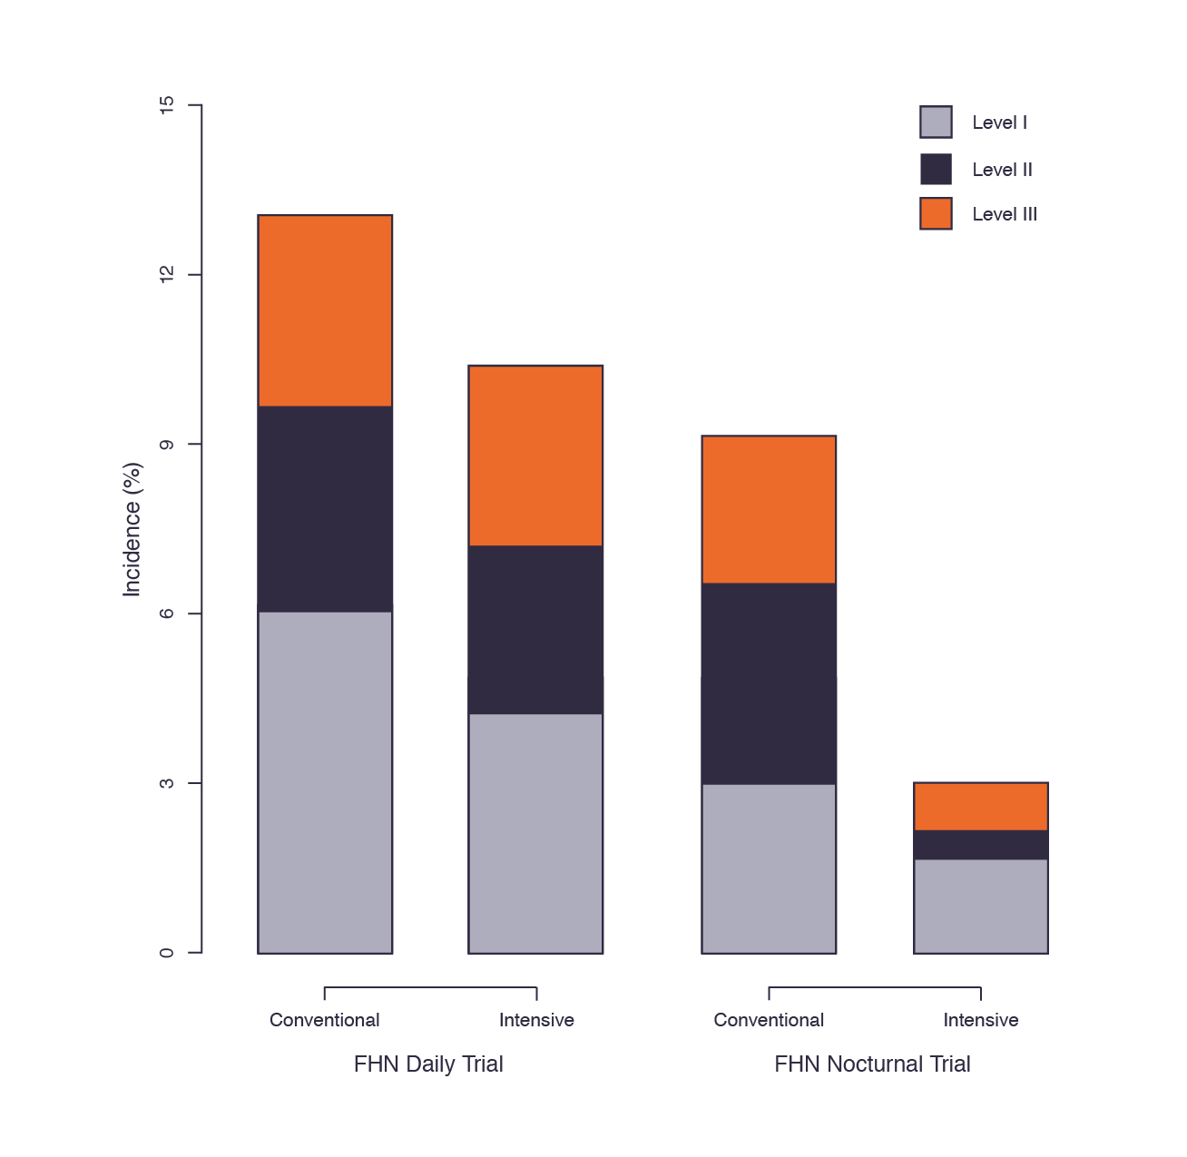
The cumulative incidence of intradialytic hypotension was significantly lower with intensive hemodialysis in both of the FHN Trials compared to conventional hemodialysis.¹
Chapter 5, Figure 2:² Incidence of levels I, II, and III intradialytic hypotension for intensive versus conventional hemodialysis in the FHN Daily Trial and the FHN Nocturnal Trial.¹
Symptoms of intradialytic hypotension were classified into 3 categories: those that led to lowering of the UF rate or reduced blood flow (Level I); those that led to the administration of saline, but not to lowering of the UF rate (Level II); and those that led to both the administration of saline and lowering of the UF rate (Level III).
21%
Reduction
67%
Reduction
¹Kotanko P, Garg AX, Depner T, et al. Effects of frequent hemodialysis on blood pressure: Results from the randomized frequent hemodialysis network trials. Hemodial Int Int Symp Home Hemodial. 2015;19(3):386-401. doi:10.1111/hdi.12255.
²Morfin, J.A., Fluck, R.J., Weinhandl, E.D., Kansal, S., McCullough, P.A., Komenda, P. Intensive hemodialysis and treatment complications and tolerability. Am J Kidney Dis. 2016;68:S43–S50.
AdvancingDialysis.org

Slide 4
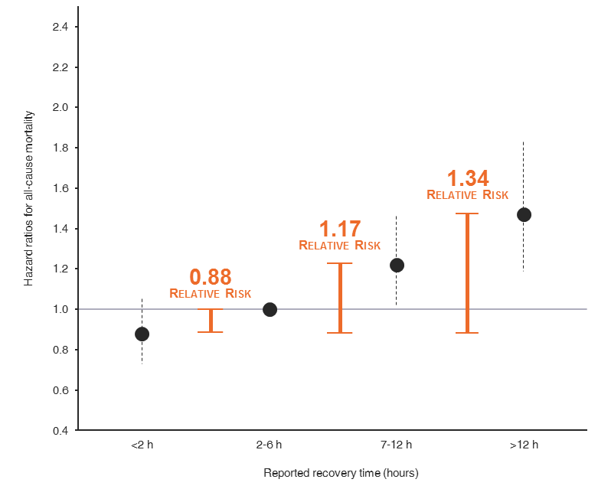
Each 1-hour increment in post-dialysis recovery time was associated with a 3% and 5% increased risk of hospitalization and death respectively.¹
Recovery time was from 2 to 6 hours in 41% of patients, from 7 to 12 hours in 17% of patients, and greater than 12 hours in 10% of patients.¹
Table 4:²
Hazard ratios for mortality by reported recovery time.
Dashed bars span one standard deviation above and below the mean.
¹Rayner HC, Zepel L, Fuller DS, et al. Recovery time, quality of life, and mortality in hemodialysis patients: the Dialysis Outcomes and Practice Patterns Study (DOPPS). Am J Kidney Dis Off J Natl Kidney Found. 2014;64(1):86-94. doi:10.1053/j.ajkd.2014.01.014.
²Morfin, J.A., Fluck, R.J., Weinhandl, E.D., Kansal, S., McCullough, P.A., Komenda, P. Intensive hemodialysis and treatment complications and tolerability. Am J Kidney Dis. 2016;68:S43–S50.
AdvancingDialysis.org

Slide 5
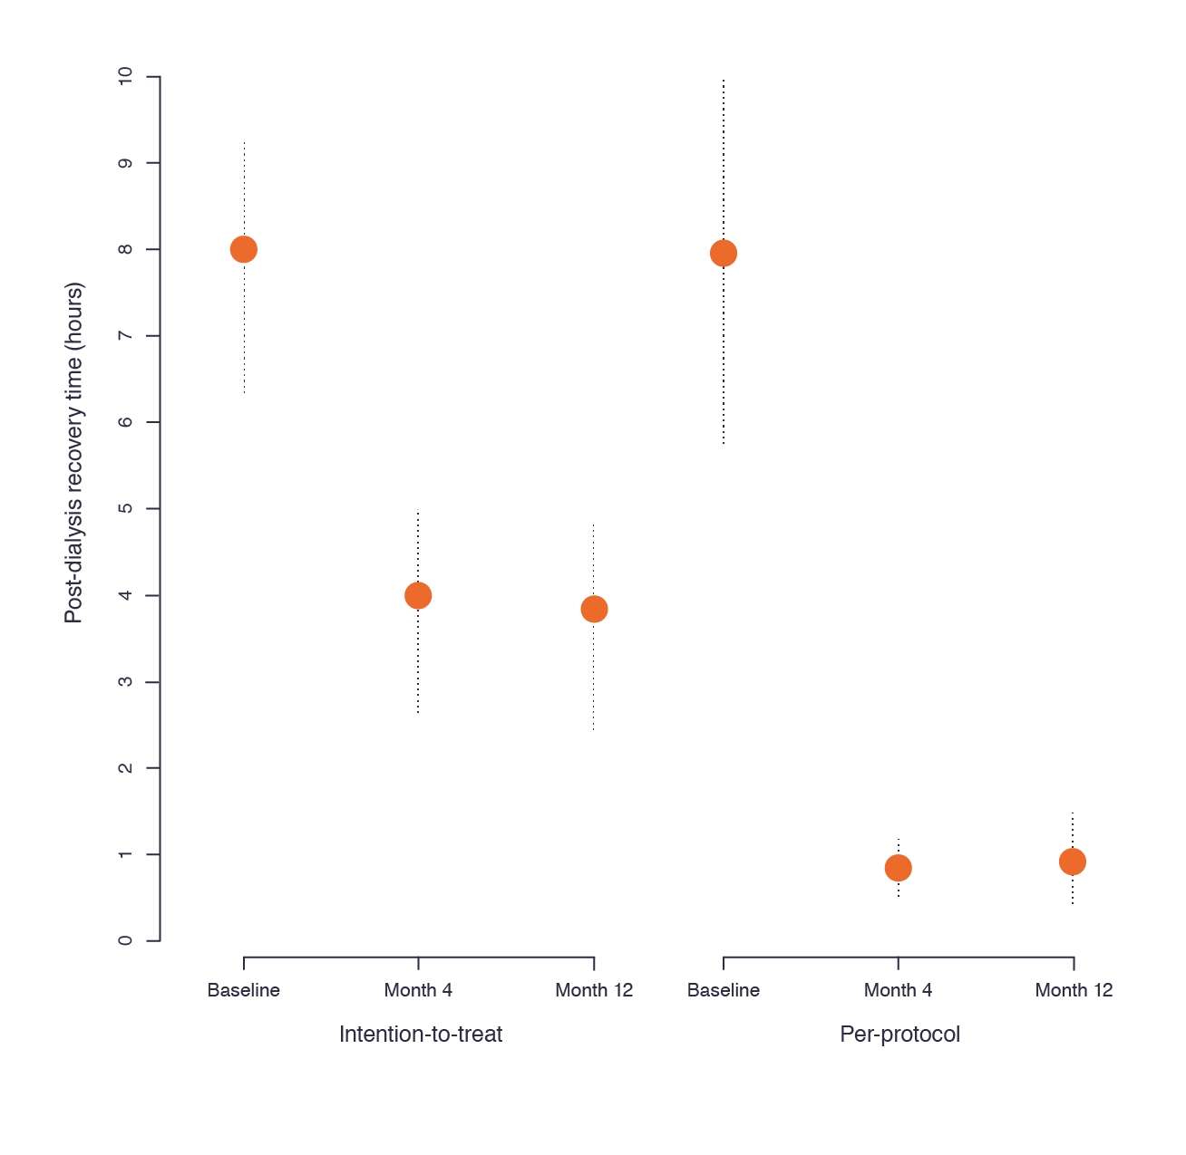
In FREEDOM Study, mean post-dialysis recovery time fell from 7.9 hours at baseline to 1.0 hours at 4 months, and to 1.1 hours at 12 months.¹
The percentage of patients with recovery time less than 1 hour increased from 19% at baseline to 65% after 12 months.¹
Chapter 5, Figure 4:² Mean post-dialysis recovery time in intention-to-treat and per-protocol cohorts of the FREEDOM study.¹
Dashed bars span one standard deviation above and below the mean.
¹Jaber BL, Lee Y, Collins AJ, et al. Effect of daily hemodialysis on depressive symptoms and postdialysis recovery time: interim report from the FREEDOM (Following Rehabilitation, Economics and Everyday-Dialysis Outcome Measurements) Study. Am J Kidney Dis Off J Natl Kidney Found. 2010;56(3):531-539. doi:10.1053/j.ajkd.2010.04.019..08
²Morfin, J.A., Fluck, R.J., Weinhandl, E.D., Kansal, S., McCullough, P.A., Komenda, P. Intensive hemodialysis and treatment complications and tolerability. Am J Kidney Dis. 2016;68:S43–S50.
AdvancingDialysis.org

