Slide 1
Cardiac Arrhythmias in Dialysis Patients
Timing and Frequency of Arrhythmias with Continuous Monitoring
Notes:
New

Slide 2
Increased risk of sudden cardiac death in dialysis patients¹
Decreased eGFR has been suggested to cause endocardial and diffuse myocardial fibrosis that could increase the risk of life-threatening ventricular arrhythmias and sudden cardiac death (SCD)²
Each 10 mL/min/1.73 m² decline in eGFR has been associated with an 11% increased risk of SCD¹
¹Pun, P.H. et al. Chronic kidney disease is associated with increased risk of sudden cardiac death among patients with coronary artery disease. Kidney International (2009) 76, 652–658.
²Mark PB, Johnston N, Groenning BA et al. Redefinition of uremic cardiomyopathy by contrast-enhanced cardiac magnetic resonance imaging. Kidney Int 2006; 69: 1839–1845.
³Hayashi M., Shimizu W., Albert C.M. The Spectrum of Epidemiology Underlying Sudden Cardiac Death. Circulation Research. 2015;116:1887-1906

Slide 3
No recent progress in sudden cardiac death¹
Monitoring in Dialysis (MiD) Study
Aimed to estimate the proportion of thrice-weekly hemodialysis patients who experienced clinically significant arrhythmias
6-months of follow-up
Sudden cardiac death
Acute myocardial infarction
¹Wetmore JB, Gilbertson DT, Liu J, Collins AJ. Improving outcomes in patients receiving dialysis: The Peer Kidney Care Initiative, Clin J Am Soc Nephrol. 2016 Jul 7;11(7):1297-304. Figure 4.5.

Slide 4
Clinically significant arrhythmias were defined prospectively and examined¹
Ventricular tachycardia ≥130 beats per minute for ≥30 seconds
Bradycardia ≤40 beats per minute for ≥6 seconds
Asystole for ≥3 seconds
Symptomatic events with electrocardiography-confirmed arrhythmia
66 patients enrolled; 62 (94%) completed 6 months of follow-up and the devices also detected atrial fibrillation
¹Charytan, D.M., et al. Arrhythmia and Sudden Death in Hemodialysis Patients: Protocol and Baseline Characteristics of the Monitoring in Dialysis Study. Clin J Am Soc Nephrol. 2016;11:721–734
Notes:
The study enrolled 66 patients; 62 (94%) completed 6 months of follow-up and the devices also detected atrial fibrillation.

Slide 5
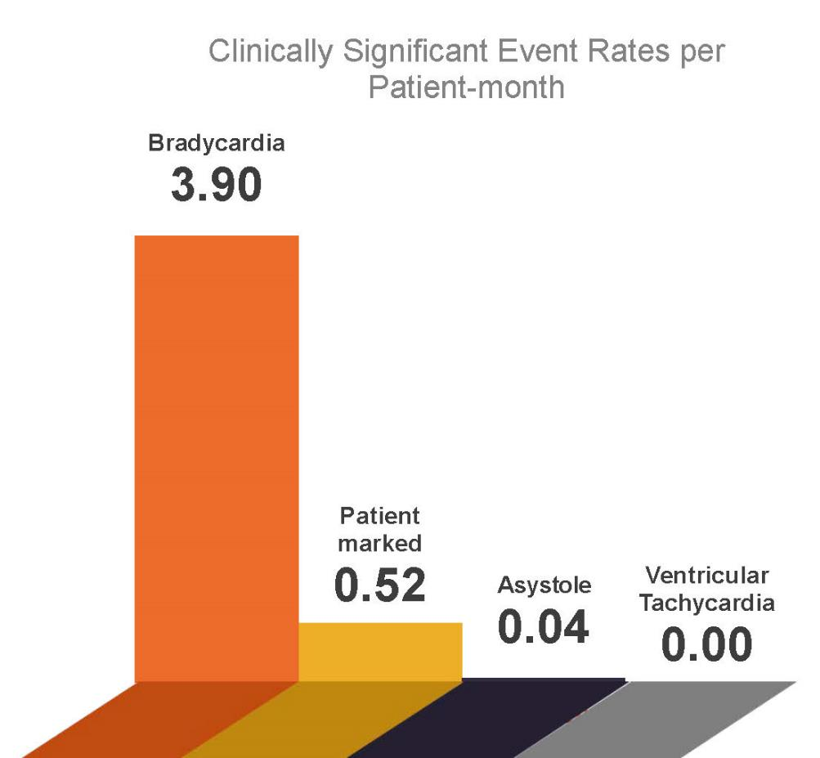
2/3 patients experienced clinically significant arrhythmias¹
Incidence rate of clinically significant arrhythmias was
4.5 events per patient-month (1,678 events)
Leading arrhythmia was bradycardia
3.9 events per patient-month
Significantly lower rate of ventricular tachycardia or asystole
¹Roy-Chaudhury, P., et al. Primary outcomes of the Monitoring in Dialysis Study indicate that clinically significant arrhythmias are common in hemodialysis patients and related to dialytic cycle. Kidney Int. 2018;93:941–951.

Slide 6
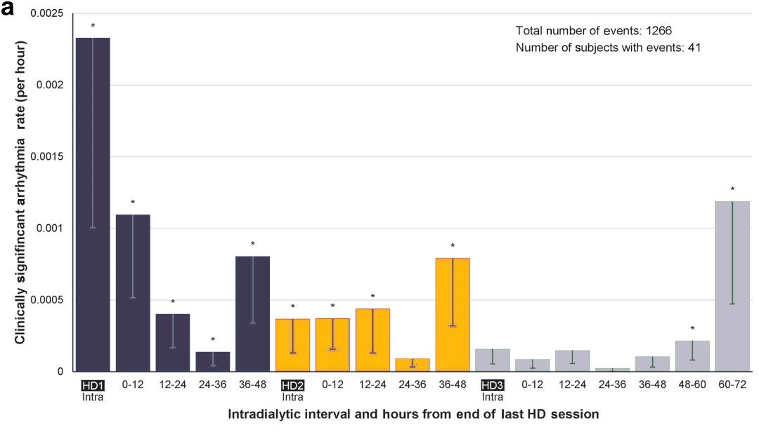
Clear patterns of clinically significant arrhythmias¹
Highest during the first hemodialysis session of the week
2nd highest during the final 12 hours of the long interdialytic gap
3rd highest during the 12 hours immediately following the first session of the week
Meaningfully elevated during the final 12 hours of each of the short interdialytic gaps
¹Roy-Chaudhury, P., et al. Primary outcomes of the Monitoring in Dialysis Study indicate that clinically significant arrhythmias are common in hemodialysis patients and related to dialytic cycle. Kidney Int. 2018;93:941–951.
Notes:
Still formatting

Slide 7
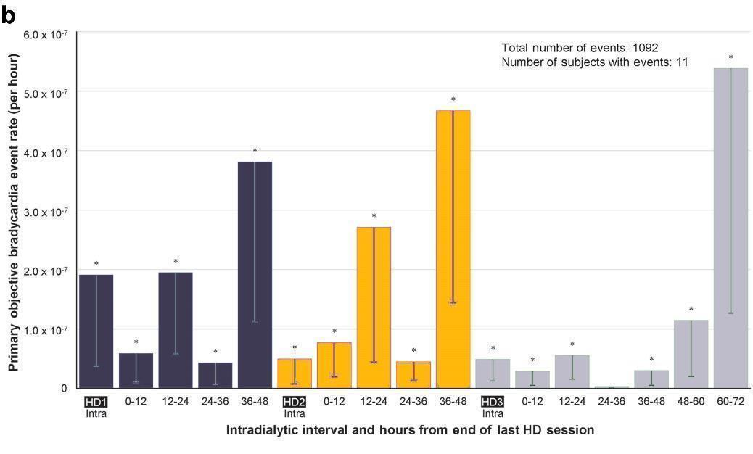
Striking patterns of bradycardic events¹
Highest during the final 12 hours of the long interdialytic gap
2nd highest during the final 12 hours before the last hemodialysis session of the week
3rd highest during the final 12 hours before the second session of the week
Also notably higher in the beginning of the 1st run vs. the beginning of the 2nd and 3rd run
¹Roy-Chaudhury, P., et al. Primary outcomes of the Monitoring in Dialysis Study indicate that clinically significant arrhythmias are common in hemodialysis patients and related to dialytic cycle. Kidney Int. 2018;93:941–951.
Notes:
Still formatting

Slide 8
Clinically significant arrhythmias were defined prospectively and examined¹
Ventricular tachycardia ≥130 beats per minute for ≥30 seconds
Definition did not include:
Sinus tachycardia
Atrial arrhythmia
Other bradycardia
Bradycardia ≤40 beats per minute for ≥6 seconds
Asystole for ≥3 seconds
Symptomatic events with electrocardiography-confirmed arrhythmia
66 patients enrolled; 62 (94%) completed 6 months of follow-up and the devices also detected atrial fibrillation
¹Charytan, D.M., et al. Arrhythmia and Sudden Death in Hemodialysis Patients: Protocol and Baseline Characteristics of the Monitoring in Dialysis Study. Clin J Am Soc Nephrol. 2016;11:721–734
Notes:
The study enrolled 66 patients; 62 (94%) completed 6 months of follow-up and the devices also detected atrial fibrillation.

Slide 9
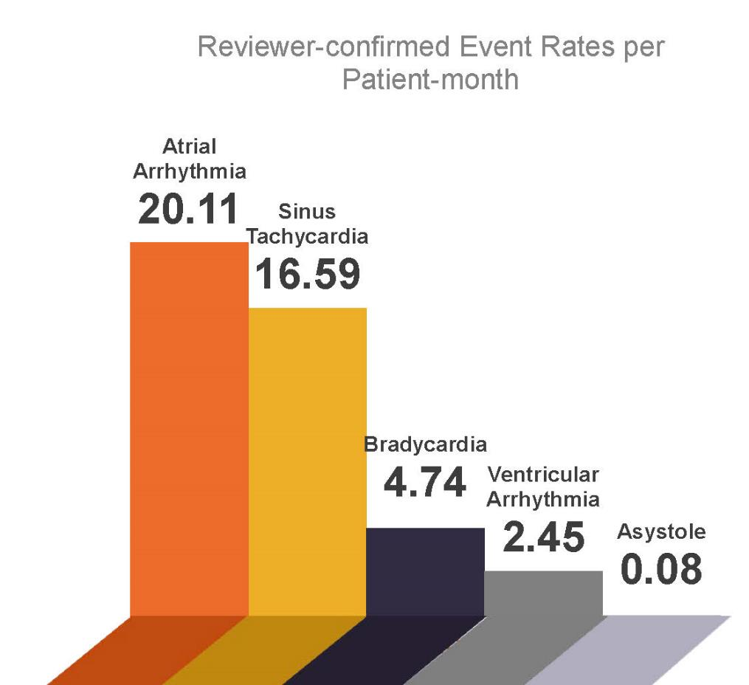
97% patients experienced reviewer-confirmed arrhythmias¹
Incidence rate of arrhythmias not meeting definition of clinically significant arrhythmias (CSA) were
33.74 events per patient-month (12,480 events)
Leading arrhythmias were atrial and sinus tachycardia
Significantly lower rate of ventricular tachycardia or asystole; similar to CSA findings
¹Roy-Chaudhury, P., et al. Primary outcomes of the Monitoring in Dialysis Study indicate that clinically significant arrhythmias are common in hemodialysis patients and related to dialytic cycle. Kidney Int. 2018;93:941–951.

Slide 10
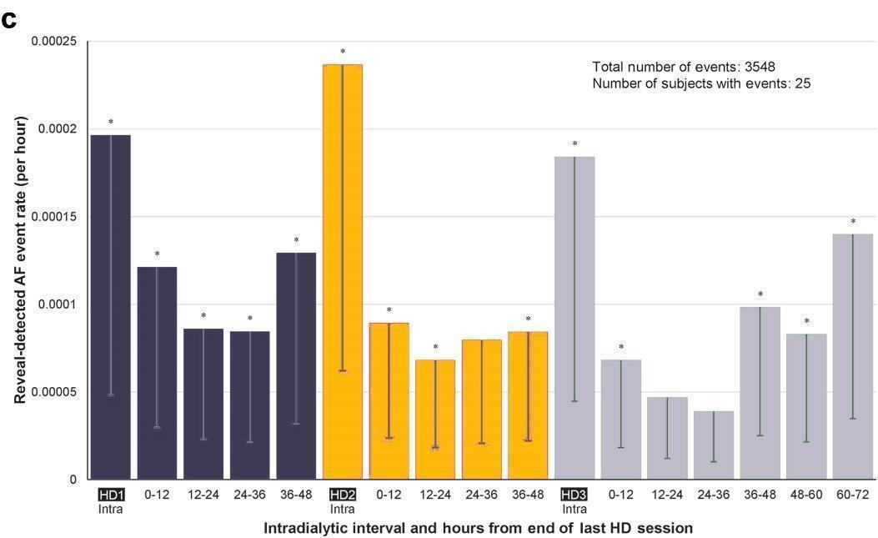
Timing of device-detected atrial fibrillation¹
Atrial fibrillation frequency spiked during hemodialysis sessions, then decreased slowly over the next 24 – 36 hours
Climbed during the last 36 hours of the long interdialytic gap
¹Roy-Chaudhury, P., et al. Primary outcomes of the Monitoring in Dialysis Study indicate that clinically significant arrhythmias are common in hemodialysis patients and related to dialytic cycle. Kidney Int. 2018;93:941–951.
Notes:
Still formatting

Slide 11
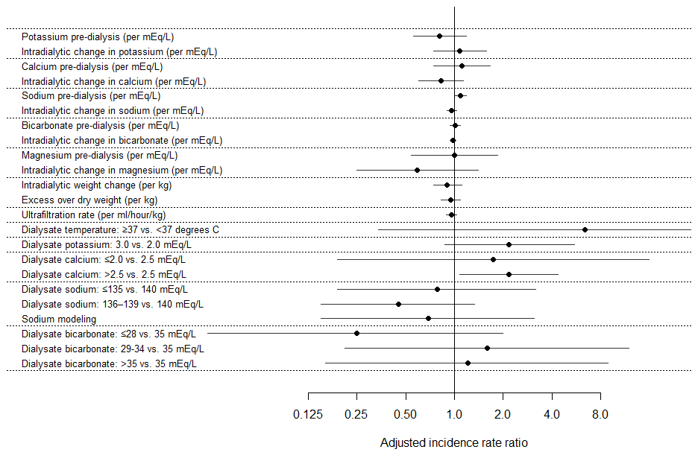
Factors associated with
arrhythmias¹
Adjusted associations of serum electrolytes and dialysate parameters with CSA rate from the start of one session to the beginning of the next
In unadjusted analyses comparing sessions with versus without arrhythmia:
Dialysate temperature was more likely to be ≥37℃
Dialysate calcium was more likely to be 2.5 mEq/L
Sodium modeling was likely to be employed
¹Roy-Chaudhury, P., et al. Table 5. Primary outcomes of the Monitoring in Dialysis Study indicate that clinically significant arrhythmias are common in hemodialysis patients and related to dialytic cycle. Kidney Int. 2018;93:941–951.

Slide 12
Conclusions¹
Sudden cardiac arrest is the leading cause of death on dialysis, but progress in reducing risk has slowed
Continuous cardiac monitoring now shows that arrhythmias – including bradycardia and atrial fibrillation – occur frequently in conventional hemodialysis patients
The timing of arrhythmias strongly suggests that the hemodialysis prescription is related to events
Multiple strategies are likely needed to mitigate risk of arrhythmias
More studies of clinical strategies are urgently needed
¹Roy-Chaudhury, P., et al. Table 5. Primary outcomes of the Monitoring in Dialysis Study indicate that clinically significant arrhythmias are common in hemodialysis patients and related to dialytic cycle. Kidney Int. 2018;93:941–951.

Slide 13
Broader context as summarized by Dr. Allan J. Collins:
University of Minnesota School of Medicine
Chief Medical Officer for NxStage Medical, Inc.
Hemodialysis frequency, interdialytic gap length, dialysate composition, and cardiovascular medications (e.g., beta blockers) are plausible risk factors for arrhythmia
Potential strategies to reduce the risk of arrhythmia may include:
Alter hemodialysis frequency and duration
Adjust electrolyte concentrations in the dialysate
Lower the dialysate temperature
Modify prescriptions of cardiovascular medication and/or oral potassium binders
Dr. Collins has held several leadership roles at the National Kidney Foundation (NKF), serving as president for two years, and on the NKF scientific advisory board for six years, and with the Kidney Dialysis Outcomes Quality Initiative. Dr. Collins is the Chief Medical Officer for NxStage Medical, Inc.
Notes:
Roy-Chaudhury, P., et al. Table 5. Primary outcomes of the Monitoring in Dialysis Study indicate that clinically significant arrhythmias are common in hemodialysis patients and related to dialytic cycle. Kidney Int. 2018;93:941–951.
Lainscak, M. How To Improve Adherence To Life-Saving Heart Failure Treatments With Potassium Binders. Card Fail Rev. 2017;3(1):33–9.

Slide 14
About this presentation
This presentation is one in an ongoing series focused on recent articles, clinical findings or guidelines related to issues affecting dialysis patients.
AdvancingDialysis.org is dedicated to providing clinicians and patients with better access to and more awareness of the reported clinical benefits and improved quality of life made possible with home dialysis, including more frequent, solo, more intensive, and nocturnal therapy schedules.
For more information, visit AdvancingDialysis.org
AdvancingDialysis.org is a project of NxStage Medical, Inc.

Slide 15
Potential Risks
Not everyone will experience the reported benefits of home and more frequent hemodialysis. All forms of hemodialysis involve some risks. When vascular access is exposed to more frequent use, infection of the site, and other access related complications may also be potential risks.
Certain risks associated with hemodialysis treatment are increased when performing solo home hemodialysis because no one is present to help the patient respond to health emergencies.
Certain risks associated with hemodialysis treatment are increased when performing nocturnal therapy due to the length of treatment time and because the patient and care partner are sleeping.

Slide 16
www.AdvancingDialysis.org
© 2018 NxStage Medical, Inc.
Notes:
Changed color – APM2302

