Slide 1
Recasting Kidney Failure as Cardiovascular Disease
a state of persistent fluid overload

Slide 2
ESRD: Represents 7% of the Medicare Budget Treats Only 1% of the US Population¹
The rising number and costs of the dialysis population continues to attract policy makers attention.
Policy makers including, the US Government Accountability Office, suggest home therapies should be expanded and barriers addresses
The challenge with increasing the use of home therapies centers on the type of the dialysis modality used, how they are applied and the barriers to utilization
The modalities need to address the chronic diseases which are major drivers of morbidity and mortality as compared to “uremia”
How home dialysis modalities address these chronic diseases and how patients feel on therapy is the ongoing challenge to moving more patients to the home setting while improving efficacy of therapy
¹USRDS 2018 Vol 2 Figure 9.2: Trends in (a) total Medicare & ESRD fee-for-service spending ($, in billions), and (b) ESRD spending as percentage of Medicare fee-for-service spending, 2004-2016

Slide 3
Total Medicare Healthcare Expenditures for Dialysis Patients
Steadily has Risen to more than $35 billion/year
USRDS 2005 & 2018 Ref Table K.1: Total Medicare spending ($) of reported ESRD patients by claim type

Slide 4
Medicare per Capita Expenditures have Stabilized
Spend per patient:
Relatively Flat Since 2009
USRDS 2018 Ref Table K.6 & USRDS 2005 Ref Table K.5: Per person per year spending ($): dialysis patients, with unknown modalities dropped (model 1); period prevalent patients, as-treated model, primary payer only, by age, sex, race, ethnicity & primary diagnosis. 2005:as-treated model, Medicare primary payor only

Slide 5
Dialysis Patient Population Increasing 2016 Population: Over 500,000+
Increased Spend Driven by Increased Patient Census
USRDS 2018 Ref Table D.1: Percentages & counts of reported ESRD patients: by treatment modality incident & December 31 point prevalent patients

Slide 6
Dialysis Patient Population Growth Slowing Growth Rate
Growth Rate:
Fallen to Below 2%
USRDS 2018 Ref Table D.1: Percentages & counts of reported ESRD patients: by treatment modality incident & December 31 point prevalent patients

Slide 7
Annual Mortality Dialysis Death Rates Have Stabilized
Hemodialysis Death Rate: Relatively Flat Since 2013
USRDS 2018 Ref Tables H8 & H9: Annual mortality rates: Hemodialysis & CAPD/CCPD patients, adjusted for age, sex, race, ethnicity, primary cause of ESRD, and patient vintage per 1,000 patient years at risk; period prevalent patients, by age, sex, race, ethnicity, primary cause of ESRD, & patient vintage

Slide 8
Hospitalizations and Hospital Days Dialysis Hospitalizations Have Stabilized
Hospitalizations and Days: Relatively Flat Since 2013
USRDS 2018 Ref Tables G2 & G7: Total admission rates: dialysis patients per 1,000 patient years, period prevalent patients, by age, sex, race, ethnicity, primary diagnosis, & patient vintage; Hospital days: dialysis patients per patient year, period prevalent patients, by age, sex, race, ethnicity, primary diagnosis, & patient vintage.

Slide 9
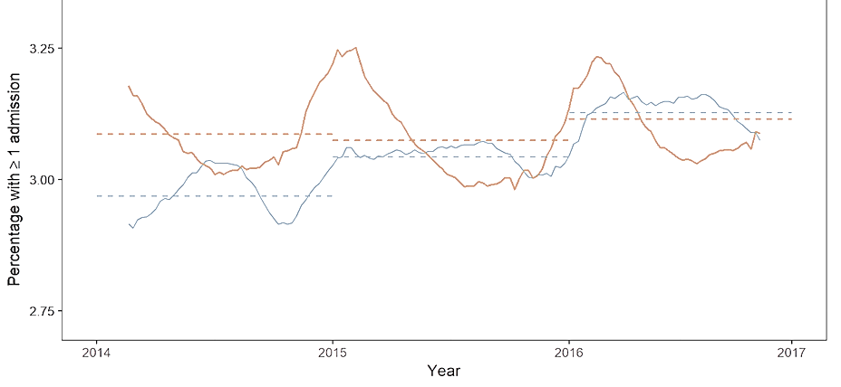
Dialysis Patient Hospitalization Utilization Trends Showing Increased Use of Emergent Care^{1,2}
Equivalent Utilization of Emergency and Observational Room Care¹
Medicare dialysis patient Hospitalizations have Stabilized²
¹Mean percentage of Medicare dialysis patients with ≥1 ER/OBS admission each week; 2014 – 2016
²Mean percentage of Medicare dialysis patients with ≥1 hospital admission each week; 2014 – 2016

Slide 10
Management of Chronic Hypertension, Left Ventricular Hypertrophy and Heart Failure The Fatal Flaw of Conventional Dialysis

Slide 11
Unmet Need in the Causal Path of Heart Disease Chronic Fluid Overload
Uncontrolled Hypertension
Left Ventricular Hypertrophy
Heart Failure
Hospitalization and Death
Fluid Overload
High Ultrafiltration Rate
Intradialytic Hypotension
Cramping, Dizziness,
Nausea, etc.
Early Sign-Offs and No-Shows¹
Limits Use of Cardioprotective Medicines
Cardiac &
organ system
Stunning
Long Post-Dialysis Recovery Time
Poor HRQoL
¹Rocco MV, Burkart JM. Prevalence of missed treatments and early sign-offs in hemodialysis patients. J Am Soc Nephrol. 1993 Nov;4(5):1178-83.
Notes:
Chronic Fluid Overload: The highest priority to address Unmet Need
Persistent hypertension and fluid overload are in the causal path for LVH and heart failure
Controlling fluid overload requires UFR on dialysis to be tolerable but may be challenging with conventional HD
Hypotension on dialysis limits the use of cardioprotective medicines
UFRs are related to cardiac stunning
UFRs are associated with recovery time
Controlling and reducing the UFR to achieve the desired volume control are challenging with conventional HD

Slide 12
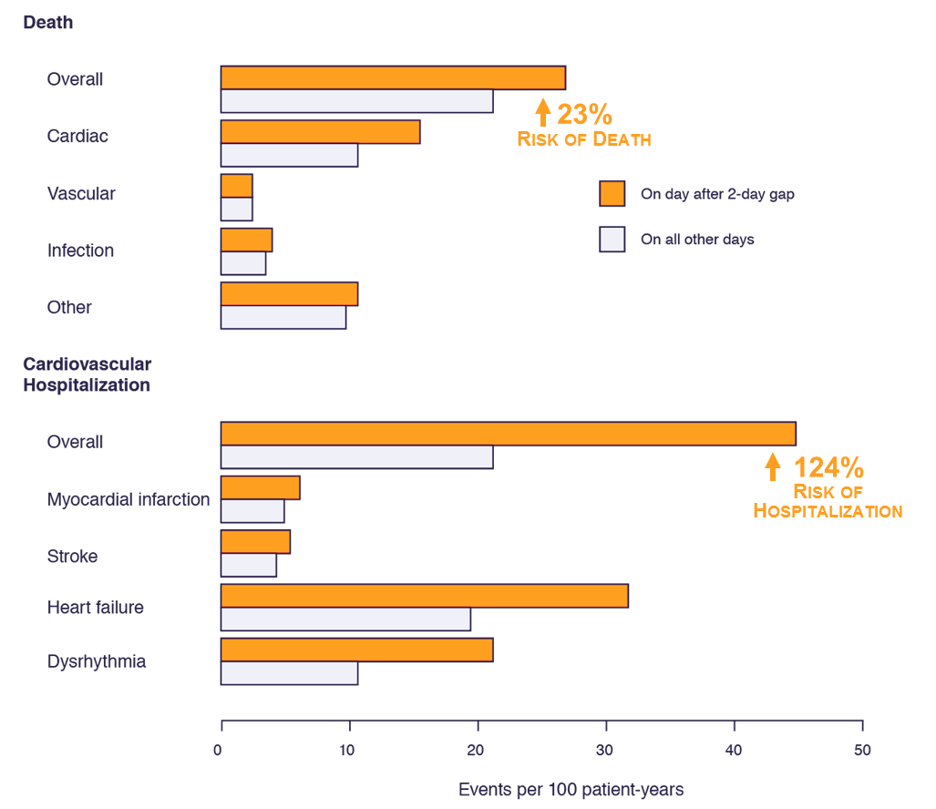
Long Interdialytic Interval is Problematic Hospitalizations and Mortality after the 2-day “Killer Gap”¹
The long interdialytic interval, commonly referred to as the 2-day “Killer Gap,” is a time of heightened risk of mortality and morbidity with conventional hemodialysis.¹
Rates of death and cardiovascular hospitalization were 23% and 124% higher after the gap, respectively, than on other days.¹
Figure: Rates of death and cardiovascular hospitalization on the day after the 2-day gap in dialysis treatment and on all others days.¹
¹Foley, R. N., Gilbertson, D. T., Murray, T., & Collins, A. J. (2011). Long interdialytic interval and mortality among patients receiving hemodialysis. New England Journal of Medicine, 365(12), 1099-1107.

Slide 13
Increased Risk of Sudden Cardiac Death¹
Decreased eGFR has been suggested to cause endocardial and diffuse myocardial fibrosis that could increase the risk of life-threatening ventricular arrhythmias and sudden cardiac death (SCD)²
Each 10 mL/min/1.73 m² decline in eGFR has been associated with an 11% increased risk of SCD¹
¹Pun, P.H. et al. Chronic kidney disease is associated with increased risk of sudden cardiac death among patients with coronary artery disease. Kidney International (2009) 76, 652–658.
²Mark PB, Johnston N, Groenning BA et al. Redefinition of uremic cardiomyopathy by contrast-enhanced cardiac magnetic resonance imaging. Kidney Int 2006; 69: 1839–1845.
³Hayashi M., Shimizu W., Albert C.M. The Spectrum of Epidemiology Underlying Sudden Cardiac Death. Circulation Research. 2015;116:1887-1906

Slide 14
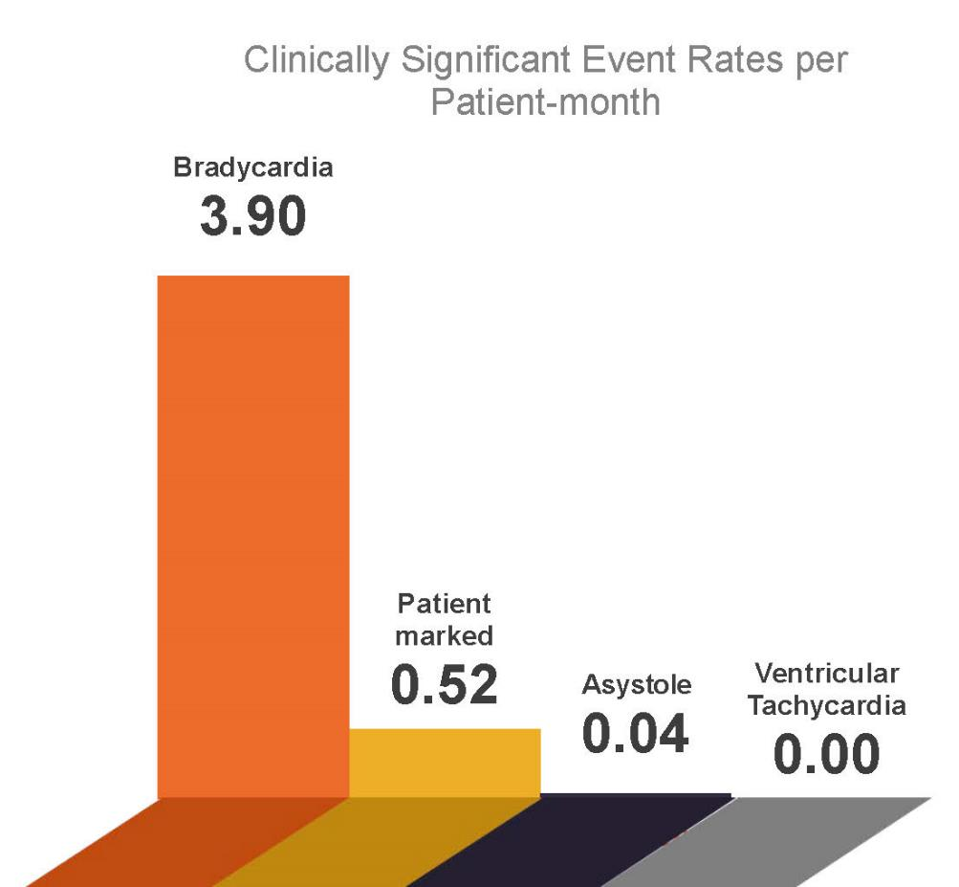
2/3 Patients Experienced Clinically Significant Arrhythmias¹
Incidence rate of clinically significant arrhythmias was
4.5 events per patient-month (1,678 events)
Leading arrhythmia was bradycardia
3.9 events per patient-month
Significantly lower rate of ventricular tachycardia or asystole
¹Roy-Chaudhury, P., et al. Primary outcomes of the Monitoring in Dialysis Study indicate that clinically significant arrhythmias are common in hemodialysis patients and related to dialytic cycle. Kidney Int. 2018;93:941–951.

Slide 15
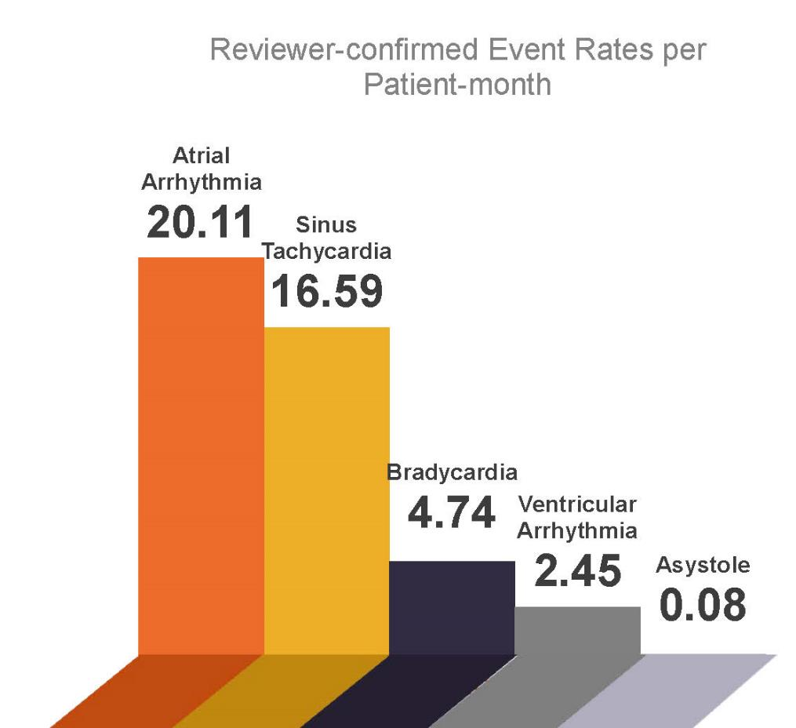
97% Patients Experienced Confirmed Arrhythmias¹
Incidence rate of arrhythmias not meeting definition of clinically significant arrhythmias (CSA) were
33.74 events per patient-month (12,480 events)
Leading arrhythmias were atrial and sinus tachycardia
Significantly lower rate of ventricular tachycardia or asystole; similar to CSA findings
¹Roy-Chaudhury, P., et al. Primary outcomes of the Monitoring in Dialysis Study indicate that clinically significant arrhythmias are common in hemodialysis patients and related to dialytic cycle. Kidney Int. 2018;93:941–951.

Slide 16
Ultrafiltration Rates over 6mL/kg/hr. Associated with Increased Risk of Death Aggressive Fluid Removal Rates and All-cause Mortality
METHODS:
118,394 hemodialysis patients in DaVita facilities, 2008-2012, with mean follow-up of 2.3 years. Mean UF rate was characterized during a 30-day baseline interval.¹
Fine and Gray proportional sub-distribution hazards regression models with kidney transplantation and dialysis modality change treated as competing risks were used to estimate the ultraﬁltration rate and all-cause mortality association.¹
Risk of Death (HR)
Rate of fluid removal from the patient -- mL/kg/hr
¹Assimon, M.M. et al. Ultrafiltration Rate and Mortality in Maintenance Hemodialysis Patients. Am J Kidney Dis. 2016;68(6):911-922
Notes:
Fluid removal rate is associated with increase mortality risk down to <6ml/kg/hr
Controlling fluid overload requires UFR on dialysis to be tolerable but may be challenging with conventional HD
Hypotension on dialysis limits the use of cardioprotective medicines

Slide 17
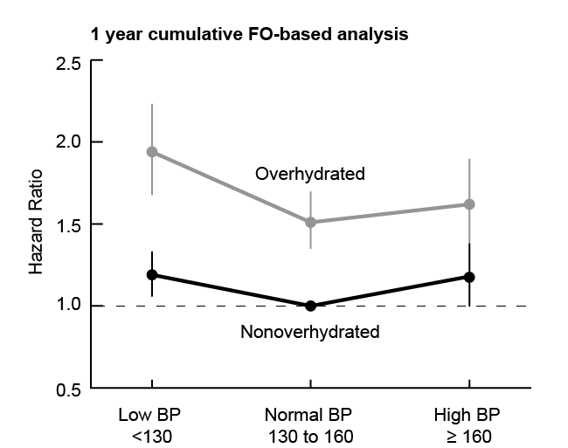
Chronic Fluid Overload Adds Mortality Risk Across all Blood Pressure strata¹
Figure 4.
1-year cumulative Fluid Overload (FO) and mortality in patients stratiﬁed by predialysis systolic BP. Data are adjusted.
Fluid-overloaded patients had a significantly higher risk of death compared with non-overloaded patients across all BP strata (all P<0.001).¹
4.8 Kg above dry ECF
0.9 Kg above dry ECF
¹Zoccali et al. Chronic Fluid Overload and Mortality in ESRD. J Am Soc Nephrol. 2017 Aug;28(8):2491-2497
Notes:
Conventional dialysis needs to change to address the unmet need directed at volume control
Risk factor awareness, treatment and control is needed in the dialysis population to address the chronic progressive CVD
Chronic Fluid Overload associated with higher risk of death

Slide 18
Characterizations of Heart Failure Classes by Severity of Symptoms
Commonly Cited: New York Heart Association Function Classiﬁcations:¹
Class | Patient Symptoms
Class I (mild) | No limitation of physical activity. Ordinary physical activity does not cause undue fatigue, palpitation, or dyspnea.
Class II (mild) | Slight limitation of physical activity. Comfortable at rest, but ordinary physical activity results in fatigue, palpitation, or dyspnea.
Class III (moderate) | Marked limitation of physical activity. Comfortable at rest, but less than ordinary activity causes fatigue, palpitation, or dyspnea.
Class IV (severe) | Unable to carry out any physical activity without discomfort. Symptoms of cardiac insufﬁciency at rest. If any physical activity is undertaken, discomfort is increased.
¹The Criteria Committee of the New York Heart Association. Diseases of the Heart and Blood Vessels: Nomenclature and Criteria for Diagnosis. 6th edition. Boston, MA: Little Brown, 1964.

Slide 19
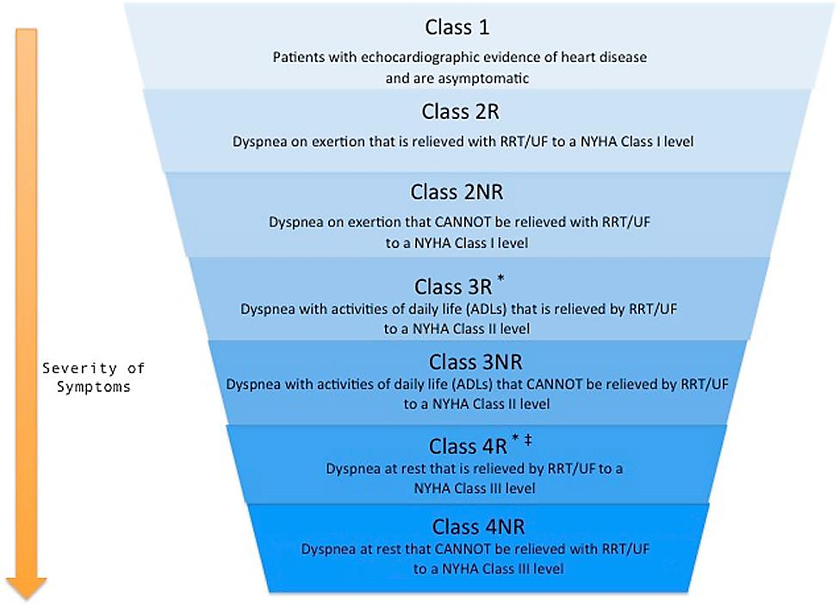
ESRD “Reactive” Classiﬁcation System ADQI Dyspnea assessment
Dyspnea pre and post hemodialysis treatment assessment
Class assignment assumes the achievement of dry weight and usual level of pre/post dyspnea
Patients scored by their post-treatment dyspnea assessment:
If dyspnea symptoms improve to class I levels, the patient would be classiﬁed as class 2R
If dyspnea symptoms improve to class II levels, the patient would be classiﬁed as class 3R.
Chawla LS, Herzog CA, Costanzo MR et al. Proposal for a Functional Classification System of Heart Failure in Patients With End-Stage Renal Disease. J Am Coll Cardiol 2014;63:1246–52
Notes:
Reactive care
Define patient not tolerating therapy:
SOB, DOE, Orthopnea, PND (HF or Fluid Overload)
Hypotension, Cramps, Post treatment prolonged recovery time
Persistent hypertension greater 140/90 for 3-6 months, greater than 2-3 meds
LVH with or without reduced systolic function, LVM >125gm/m2,
NYHA class 2-4 CHF, consistently and persistently elevation NP-Pro BNP, elevated troponins,
Persistently high PO4 (5.5+ mg/dl) for 3-6 months
PD failures with volume overload

Slide 20
NKF-KDOQI Hemodialysis Adequacy Guideline: 2015 Update
Consider additional hemodialysis sessions or longer hemodialysis treatment times for patients with:
Large weight gains
High ultrafiltration rates
Poorly controlled blood pressure
Difficulty achieving dry weight
Poor metabolic control (such as hyperphosphatemia, metabolic acidosis, and/or hyperkalemia)
Inadequate sodium/water removal to manage hypertension, hypervolemia, and left ventricular hypertrophy
National Kidney Foundation. KDOQI Clinical Practice Guideline for Hemodialysis Adequacy: 2015 Update. Am J Kidney Dis. 2015;66(5):884-930.

Slide 21
Home Dialysis Utilization Increase in Number of Home Dialysis Patients
Home Dialysis Utilization:
Remains <12% of Patients
*USRDS 2017 ADR Reference Table D.1: Percentages & counts of reported ESRD patients: by treatment modality

Slide 22
Addressing Consistent Volume Control Increased Treatment Time and Frequency
Clinical Considerations for Number of Hemodialysis Treatments per Week:*
3 T_{x} | 3.5 – 4 T_{x} | 5+ T_{x} (“Daily”) | 5+ T_{x} (“Nocturnal”)
Longer hemodialysis treatment time (ex. nocturnal treatments) has improved mortality in observational studies¹ | Could mitigate the 2-day killer gap² Possibility to decrease UFR with 2-3 additional hours of time per treatment^{3,4} | Improved BP control & survival^{1,4-8} Reduced LVH & cardiovascular hospitalizations^{4,7,8,10} Reduced UFR, recovery time & hypotensive episodes^{3-5,10-15} Improvements in sleep quality, RLS & HRQoL^{5,16-18} Limits volume loading between treatments | Benefits from 5+ days per week plus: Improved sleep and obstructive sleep apnea^{14,17} Best dialytic PO4 control^{4,20,21} Increased reduction in post dialysis recovery time¹⁵
*See references on slides 28-30
Notes:
More Frequent HD limits volume loading between treatments
Reduces the long weekend loading associated with higher morbidity and mortality
UFRs are slower enabling vascular refilling reducing hypotension
MFHD consistently improves blood pressure control and decreases the use of anti-hypertensive medication without increasing complications on dialysis
Intensive BP control on conventional dialysis requires more medications and creates greater intra-dialytic complications

Slide 23
Broader context as summarized by Dr. Allan J. Collins:
Trends in the US Dialysis population:
Rate of growth of the US dialysis has slowed to less than 2% per year
Progress on reducing death rates has not only slowed, but stagnated from 2014 to 2016
US hospitalization rates flattened with expanding use of emergency room visits and observation stays is a new, major concern
Cardiovascular disease and infection remain the leading causes of hospital visits with little progress in recent years
Long weekend, interdialytic interval is a risk for death and hospitalization on the first run of the week
How are these populations going to be managed to reduce morbidity, mortality and cost over the coming decade with shortages of physicians, nurses and inflationary costs?
Dr. Collins has held several leadership roles at the National Kidney Foundation (NKF), serving as president for two years, and on the NKF scientific advisory board for six years, and with the Kidney Dialysis Outcomes Quality Initiative. Dr. Collins is the Chief Medical Officer for NxStage Medical, Inc.

Slide 24
Critical, unmet needs in current dialysis patient care:
Chronic fluid overload
Aggressive ultrafiltration rates
Recovery time
Cardiovascular-related hospitalizations and death
Reactive classifications and care pose challenges to adequate interventions to treat heart disease and cardiovascular complications
Multiple randomized clinical trials and large observational cohort studies have shown hemodialysis that 5 or 6 sessions per week can positively address heart disease
Proactive disease management should be our aim for current and future patients entrusted to our care
Dr. Collins has held several leadership roles at the National Kidney Foundation (NKF), serving as president for two years, and on the NKF scientific advisory board for six years, and with the Kidney Dialysis Outcomes Quality Initiative. Dr. Collins is the Chief Medical Officer for NxStage Medical, Inc.

Slide 25
Proactive for either secondary or primary prevention of cardiovascular disease:
Transplant candidates →
Poor control of CVD and BMD while on waitlist could be alleviated with more frequent treatments
Pregnant patients →
Physiologic volume-loaded state is best treated with more frequent hemodialysis
Long-term health of the mother should be a rationale for more frequent and longer treatments
Sleep apnea patients →
Likely represents a volume loaded state with central edema, hypoxia and pulmonary hypertension with right heart overload
Could be mitigated with more frequent or nocturnal hemodialysis
Restless leg syndrome patients →
Likely represents persistent uremia toxins nervous system toxicity which is treated with more frequent hemodialysis
Hyper oxalosis patients →
Best treated with maximum long nocturnal, daily hemodialysis therapy

Slide 26
About this presentation
This presentation is one in an ongoing series focused on recent articles, clinical findings or guidelines related to issues affecting dialysis patients.
AdvancingDialysis.org is dedicated to providing clinicians and patients with better access to and more awareness of the reported clinical benefits and improved quality of life made possible with home dialysis, including solo and nocturnal therapy schedules.
For more information, visit AdvancingDialysis.org
AdvancingDialysis.org is a project of NxStage Medical, Inc.

Slide 27
Risks and Responsibilities
Not everyone will experience the reported benefits of home and more frequent hemodialysis. All forms of hemodialysis involve some risks. When vascular access is exposed to more frequent use, infection of the site, and other access related complications may also be potential risks.
Certain risks associated with hemodialysis treatment are increased when performing solo home hemodialysis because no one is present to help the patient respond to health emergencies.
Certain risks associated with hemodialysis treatment are increased when performing nocturnal therapy due to the length of treatment time and because the patient and care partner are sleeping.

Slide 28
Clinical Evidence for Benefits Of Increased Frequency at Home References
¹Rivara MB et al. Extended-hours hemodialysis is associated with lower mortality risk in patients with end-stage renal disease. Kidney Int. 2016 Dec;90(6):1312-1320.
²Foley, R. N., Gilbertson, D. T., Murray, T., Collins, A. J. Long interdialytic interval and mortality among patients receiving hemodialysis. NEJM. 2011;365(12):1099-1107.
³Raimann, J.G., et al. The Effect of Increased Frequency of Hemodialysis on Volume-Related Outcomes: A Secondary Analysis of the Frequent Hemodialysis Network Trials. Blood Purif 2016;41:277–286.
⁴FHN Trial Group, Chertow, G.M., Levin, N.W., Beck, G.J. et al. In-center hemodialysis six times per week versus three times per week. N Engl J Med. 2010; 363: 2287–2300.
⁵Morfin, J.A., Fluck, R.J., Weinhandl, E.D., Kansal, S., McCullough, P.A., and Komenda, P. Intensive hemodialysis and treatment complications and tolerability. Am J Kidney Dis. 2016; 68: S43–S50.
⁶Bakris, G.L., Burkart, J.M., Weinhandl, E.D., McCullough, P.A., and Kraus, M.A. Intensive hemodialysis, blood pressure, and antihypertensive medication use. Am J Kidney Dis. 2016; 68: S15–S23.
⁷Weinhandl ED, Gilbertson DT, Collins AJ. Mortality, Hospitalization, and Technique Failure in Daily Home Hemodialysis and Matched Peritoneal Dialysis Patients: A Matched Cohort Study. Am J Kidney Dis. 2016;67(1):98-110.
⁸Weinhandl, E.D., Liu, J., Gilbertson, D.T., Arneson, T.J., Collins, A.J. Survival in daily home hemodialysis and matched thrice-weekly in-center hemodialysis patients. J Am Soc Nephrol. 2012;23:895–904.
⁹Chan, C.T., Greene, T., Chertow, G.M. et al. Determinants of left ventricular mass in patients on hemodialysis: Frequent Hemodialysis Network (FHN) Trials. Circ Cardiovasc Imaging. 2012; 5: 251–261.

Slide 29
Clinical Evidence for Benefits Of Increased Frequency at Home References
¹⁰McCullough, P.A., Chan, C.T., Weinhandl, E.D., Burkart, J.M., and Bakris, G.L. Intensive hemodialysis, left ventricular hypertrophy, and cardiovascular disease. Am J Kidney Dis. 2016; 68: S5–S14.
¹¹Weinhandl, Collins, Kraus. Ultrafiltration Rates with More Frequent Home Hemodialysis. Oral Presentation. 2017 ADC.
¹²Stefánsson, B.V., Brunelli, S.M., Cabrera, C. et al. Intradialytic hypotension and risk of cardiovascular disease. Clin J Am Soc Nephrol. 2014; 9: 2124–2132.
¹³Jefferies, H.J., et al. Frequent Hemodialysis Schedules Are Associated with Reduced Levels of Dialysis-induced Cardiac Injury (Myocardial Stunning). Clin J Am Soc Nephrol. 2011 June; 6(6): 1326–1332.
¹⁴Jaber BL, Lee Y, Collins AJ, et al. Effect of daily hemodialysis on depressive symptoms and postdialysis recovery time: interim report from the FREEDOM (Following Rehabilitation, Economics and Everyday-Dialysis Outcome Measurements) Study. Am J Kidney Dis. 2010;56(3):531-539.
¹⁵Lindsay RM, Heidenheim PA, Nesrallah G, Garg AX, Suri R, Daily Hemodialysis Study Group London Health Sciences Centre. Minutes to recovery after a hemodialysis session: a simple health-related quality of life question that is reliable, valid, and sensitive to change. CJASN. 2006;1(5):952-959.
¹⁶Jaber BL, et al. Impact of Short Daily Hemodialysis on Restless Legs Symptoms and Sleep Disturbances. CJASN May 2011 vol. 6 no. 5 1049-1056.
¹⁷Finkelstien FO, et al. At-home short daily hemodialysis improves the long-term health-related quality of life. Kidney International (2012) 82, 561–569.
¹⁸Kraus, Michael A. et al. Intensive Hemodialysis and Health-Related Quality of Life. Am J of Kidney Dis. 2016;68:S33-S42.

Slide 30
Clinical Evidence for Benefits Of Increased Frequency at Home References
¹⁹Hanley, P.J., Pierratos, A. Improvement of sleep apnea in patients with chronic renal failure who undergo nocturnal hemodialysis. N Engl J Med: 2001; Vol. 344, No. 2.
²⁰Daugirdas JT, Chertow GM, Larive B, et al. Effects of frequent hemodialysis on measures of CKD mineral and bone disorder. JASN. 2012;23(4):727-738.
²¹Copland, M. et al. Intensive Hemodialysis, Mineral and Bone Disorder, and Phosphate Binder Use. Am J Kid D: 2016; Volume 68, Issue 5, Supplement 1, Pages S24–S32.

Slide 31
www.AdvancingDialysis.org
© 2018 NxStage Medical, Inc.

