Slide 1
Intensive Hemodialysis, Left Ventricular Hypertrophy and Cardiovascular Disease
McCullough PA, Chan CT, Weinhandl ED, Burkart JM, Bakris GL. Intensive Hemodialysis, Left Ventricular Hypertrophy, and Cardiovascular Disease. American Journal of Kidney Diseases, Volume 68, Issue 5, S5 - S14.
AdvancingDialysis.org

Slide 2
The long interdialytic interval, commonly referred to as the 2-day “Killer Gap,” is a time of heightened risk of mortality and morbidity with conventional hemodialysis.¹
23%
Risk of Death
Rates of death and cardiovascular hospitalization were 23% and 124% higher after the gap, respectively, than on other days.¹
Chapter 1, Figure 1: Rates of death and cardiovascular hospitalization on the day after the 2-day gap in dialysis treatment and on all others days.¹
124%
Risk of Hospitalization
¹Foley, R. N., Gilbertson, D. T., Murray, T., & Collins, A. J. (2011). Long interdialytic interval and mortality among patients receiving hemodialysis. New England Journal of Medicine, 365(12), 1099-1107.
AdvancingDialysis.org

Slide 3
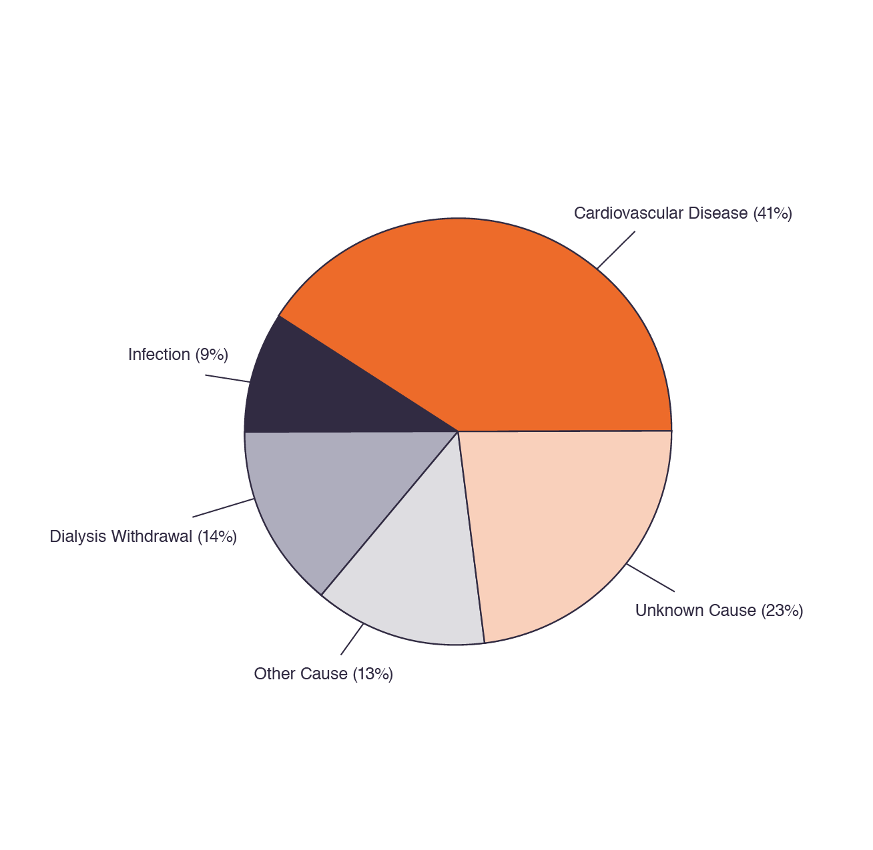
Cardiovascular-related deaths in prevalent dialysis patients are common.¹
Over 41% of all deaths were cardiovascular-related, with nearly identical percentages in hemodialysis and peritoneal dialysis patients.¹
Chapter 1, Figure 2: Distribution of primary cause of death in hemodialysis patients, 2011 to 2013.¹
¹Saran R, Li Y, Robinson B, et al. US Renal Data System 2014 Annual Data Report: Epidemiology of Kidney Disease in the United States. Am J Kidney Dis Off J Natl Kidney Found. 2015;66(1 Suppl 1):Svii, S1-305. doi:10.1053/j.ajkd.2015.05.001
AdvancingDialysis.org

Slide 4
Multiple randomized clinical trials show intensive hemodialysis significantly reduces left ventricular mass.^{1,2,3}
Chapter 1, Figure 3: Effects of intensive versus conventional hemodialysis on left ventricular mass in the FHN Daily Trial,¹ the FHN Nocturnal Trial,² and the Canadian trial of nocturnal hemodialysis.³
Estimated treatment effects (solid dots) and associated 95% confidence intervals (solid lines) are displayed at the bottom.
¹FHN Trial Group, Chertow GM, Levin NW, et al. In-center hemodialysis six times per week versus three times per week. N Engl J Med. 2010;363(24):2287-2300. doi:10.1056/NEJMoa1001593. ²Rocco MV, Lockridge RS, Beck GJ, et al. The effects of frequent nocturnal home hemodialysis: the Frequent Hemodialysis Network Nocturnal Trial. Kidney Int. 2011;80(10):1080-1091. doi:10.1038/ki.2011.213. ³Culleton BF, Walsh M, Klarenbach SW, et al. Effect of frequent nocturnal hemodialysis vs. conventional hemodialysis on left ventricular mass and quality of life: a randomized controlled trial. JAMA. 2007;298(11):1291-1299. doi:10.1001/jama.298.11.1291.
-13.8 g
-10.9 g
-15.3 g
AdvancingDialysis.org

Slide 5
Short daily hemodialysis was associated with lower risk of cardiovascular-related hospitalization, compared to conventional in-center hemodialysis.¹
Short daily hemodialysis was associated with lower risks of hospitalization due to cerebrovascular disease, heart failure/fluid overload, and hypertensive disease.¹
Chapter 1, Figure 4: Relative hazards of cause-specific cardiovascular hospitalization for short daily hemodialysis versus in-center hemodialysis¹ and versus peritoneal dialysis.²
Solid lines represent 95% confidence intervals around estimated hazard ratios (solid dots). Abbreviations: CIHD, in-center hemodialysis; PD, peritoneal dialysis; SDHD, short daily hemodialysis
¹Weinhandl ED, Nieman KM, Gilbertson DT, Collins AJ. Hospitalization in daily home hemodialysis and matched thrice-weekly in-center hemodialysis patients. Am J Kidney Dis Off J Natl Kidney Found. 2015;65(1):98-108. doi:10.1053/j.ajkd.2014.06.015. ²Weinhandl ED, Gilbertson DT, Collins AJ. Mortality, Hospitalization, and Technique Failure in Daily Home Hemodialysis and Matched Peritoneal Dialysis Patients: A Matched Cohort Study. Am J Kidney Dis Off J Natl Kidney Found. 2016;67(1):98-110. doi:10.1053/j.ajkd.2015.07.014.
AdvancingDialysis.org

Slide 6
Short daily hemodialysis was associated with lower risks of cardiovascular-related hospitalization, compared to peritoneal dialysis.¹
Hospitalization due to cerebrovascular disease, heart failure / fluid overload, hypertensive and peripheral artery diseases were lower.¹
Chapter 1, Figure 4: Relative hazards of cause-specific cardiovascular hospitalization for short daily hemodialysis versus in-center hemodialysis² and versus peritoneal dialysis.¹
Solid lines represent 95% confidence intervals around estimated hazard ratios (solid dots). Abbreviations: CIHD, in-center hemodialysis; PD, peritoneal dialysis; SDHD, short daily hemodialysis.
¹Weinhandl ED, Gilbertson DT, Collins AJ. Mortality, Hospitalization, and Technique Failure in Daily Home Hemodialysis and Matched Peritoneal Dialysis Patients: A Matched Cohort Study. Am J Kidney Dis Off J Natl Kidney Found. 2016;67(1):98-110. doi:10.1053/j.ajkd.2015.07.014. ²Weinhandl ED, Nieman KM, Gilbertson DT, Collins AJ. Hospitalization in daily home hemodialysis and matched thrice-weekly in-center hemodialysis patients. Am J Kidney Dis Off J Natl Kidney Found. 2015;65(1):98-108. doi:10.1053/j.ajkd.2014.06.015.
AdvancingDialysis.org

