Slide 1
Intensive Hemodialysis and Health-related Quality of Life
Kraus MA, Fluck RJ, Weinhandl ED, Kansal S, Copland M, Komenda P, Finkelstein FO. Intensive Hemodialysis and Health-Related Quality of Life. American Journal of Kidney Diseases, Volume 68, Issue 5, S33 - S42.
AdvancingDialysis.org

Slide 2
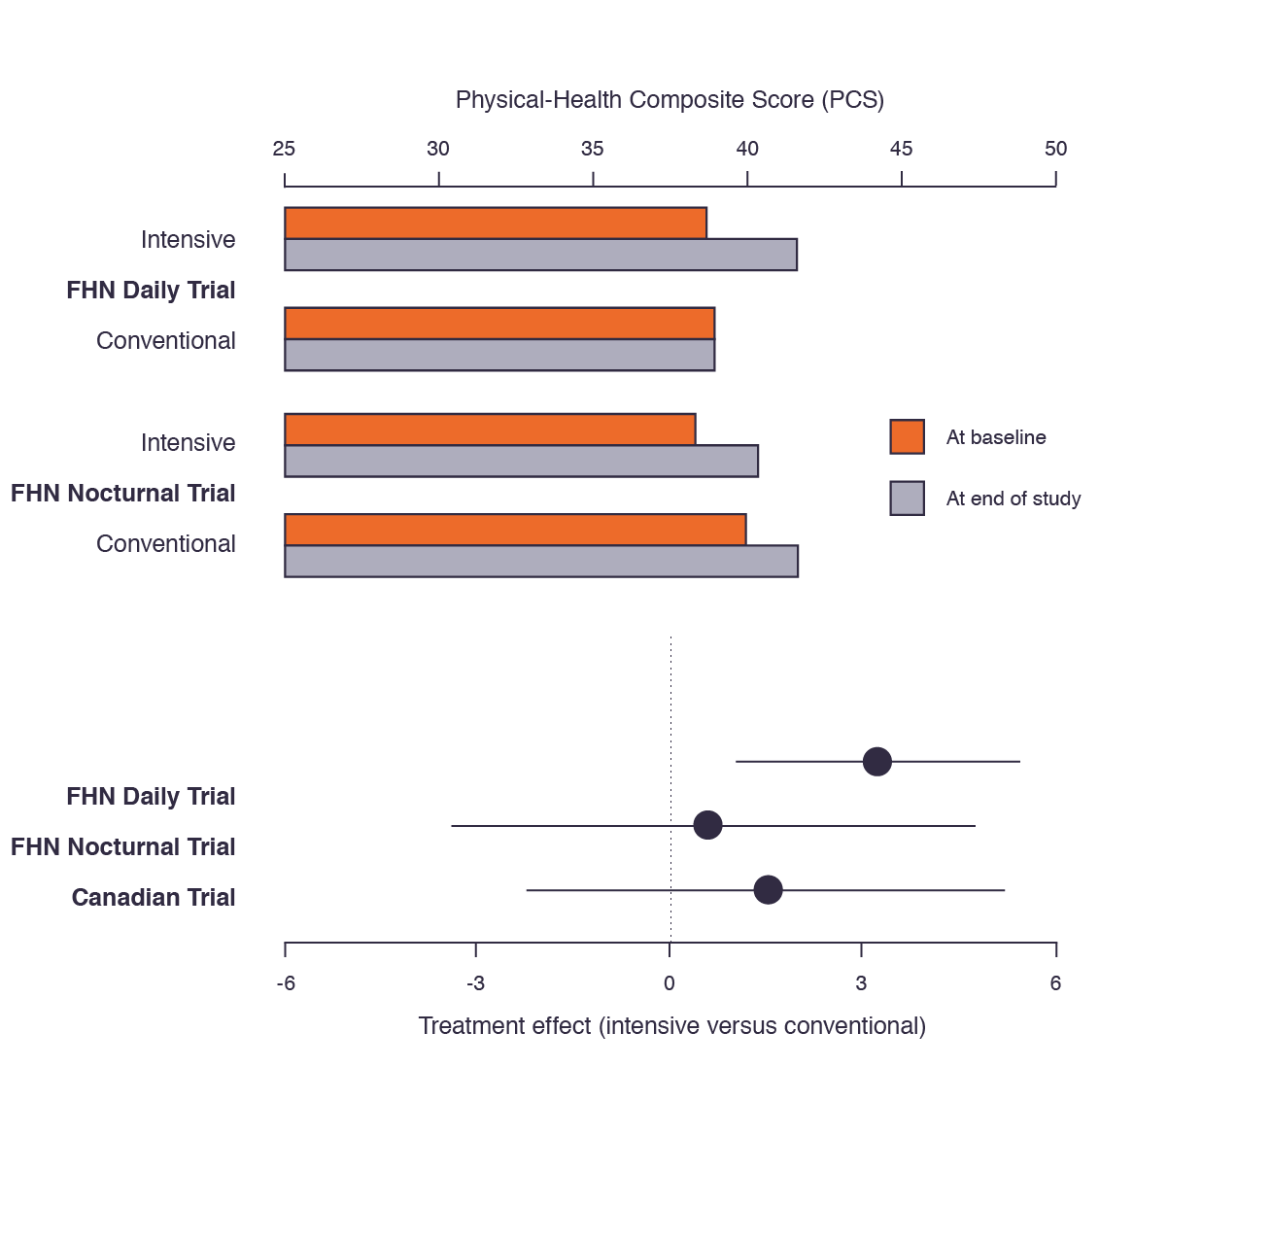
Intensive hemodialysis improved physical health-related quality of life in three randomized clinical trials, although the significance of individual effects varied.^{1,2,3}
Chapter 4, Figure 1: Effects of intensive versus conventional hemodialysis on the physical-health composite score in the FHN Daily Trial,¹ the FHN Nocturnal Trial,² and the Canadian trial of nocturnal hemodialysis.³
Estimated treatment effects (solid dots) and associated 95% confidence intervals (solid lines) are displayed at the bottom.
¹FHN Trial Group, Chertow GM, Levin NW, et al. In-center hemodialysis six times per week versus three times per week. N Engl J Med. 2010;363(24):2287-2300. doi:10.1056/NEJMoa1001593. ²Rocco MV, Lockridge RS, Beck GJ, et al. The effects of frequent nocturnal home hemodialysis: the Frequent Hemodialysis Network Nocturnal Trial. Kidney Int. 2011;80(10):1080-1091. doi:10.1038/ki.2011.213. ³Manns BJ, Walsh MW, Culleton BF, et al. Nocturnal hemodialysis does not improve overall measures of quality of life compared to conventional hemodialysis. Kidney Int. 2009;75(5):542-549. doi:10.1038/ki.2008.639.
+3.2 PCS
+0.6 PCS
+1.5 PCS
AdvancingDialysis.org

Slide 3
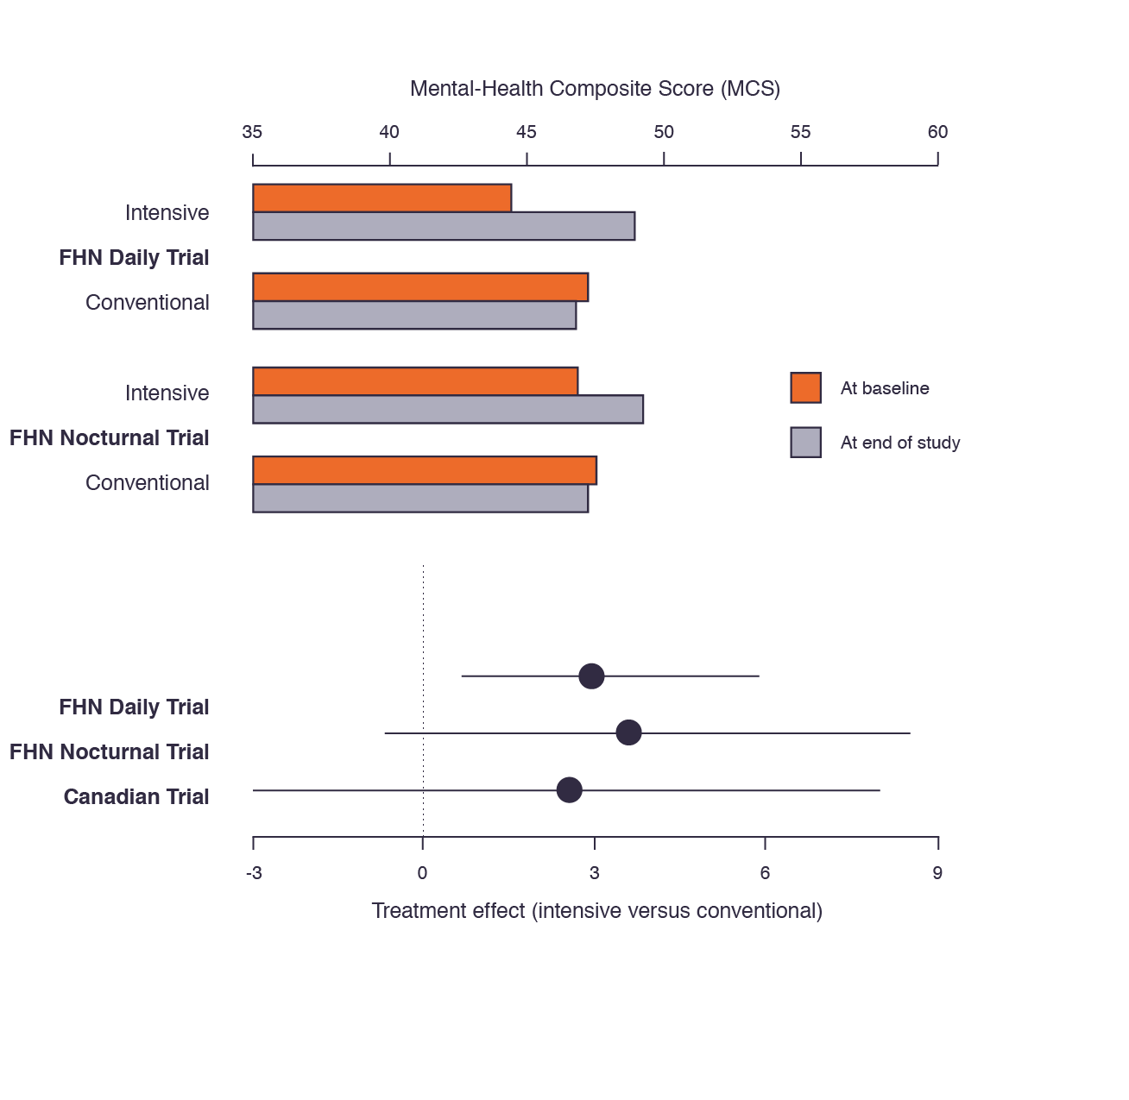
Intensive hemodialysis also improved mental health-related quality of life in three randomized clinical trials, although the significance of individual effects varied.^{1,2,3}
Chapter 4, Figure 2: Effects of intensive versus conventional hemodialysis on the physical-health composite score in the FHN Daily Trial,¹
the FHN Nocturnal Trial,² and the Canadian trial of nocturnal hemodialysis.³
Estimated treatment effects (solid dots) and associated 95% confidence intervals (solid lines) are displayed at the bottom.
¹Unruh ML, Larive B, Chertow GM, et al. Effects of 6-times-weekly versus 3-times-weekly hemodialysis on depressive symptoms and self-reported mental health: Frequent Hemodialysis Network (FHN) Trials. Am J Kidney Dis Off J Natl Kidney Found. 2013;61(5):748-758. doi:10.1053/j.ajkd.2012.11.047. ²Manns BJ, Walsh MW, Culleton BF, et al. Nocturnal hemodialysis does not improve overall measures of quality of life compared to conventional hemodialysis. Kidney Int. 2009;75(5):542-549. doi:10.1038/ki.2008.639.
+3.5 MCS
+3.7 MCS
+2.5 MCS
AdvancingDialysis.org

Slide 4
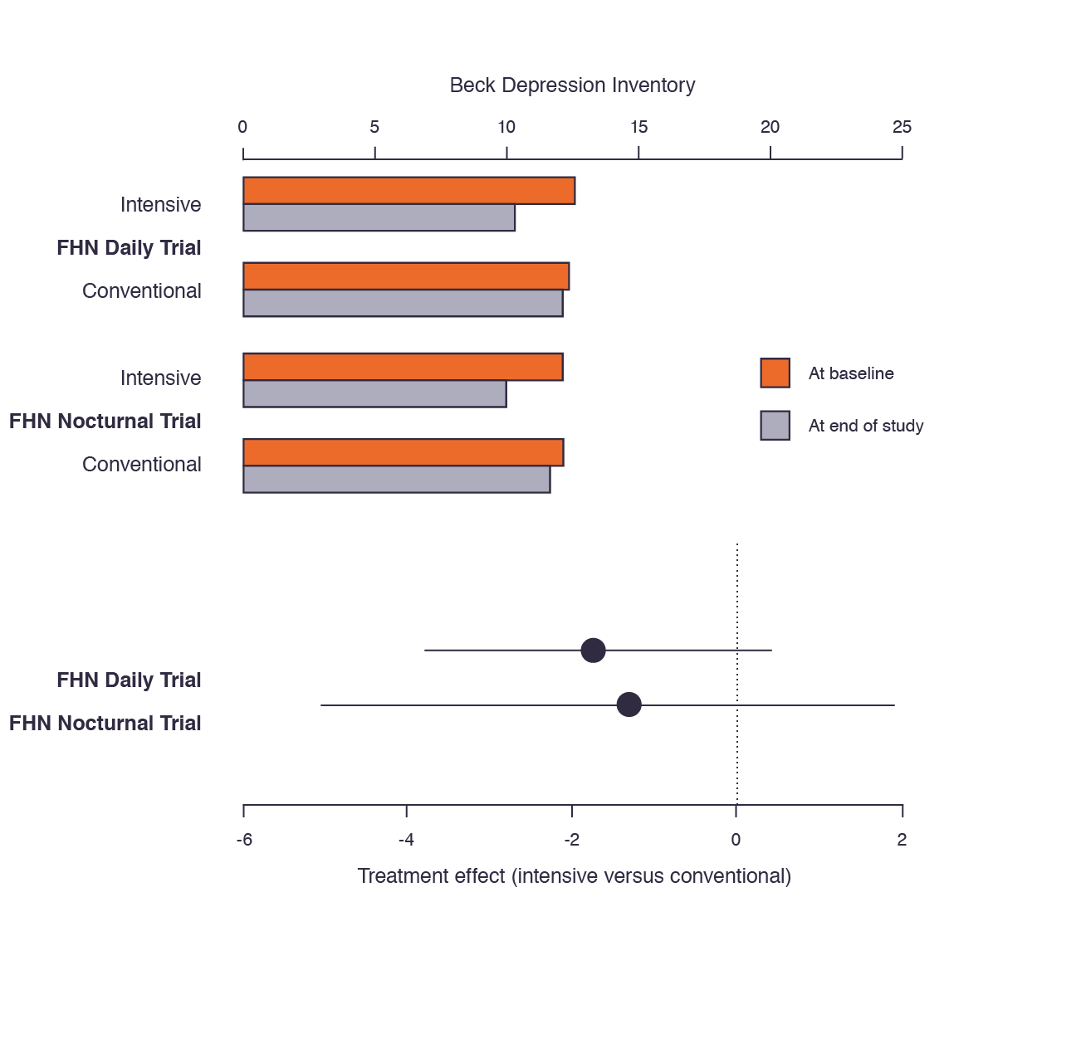
In the FHN trials, intensive hemodialysis decreased Beck Depression Inventory scores more so than conventional hemodialysis.^{1,2}
Chapter 4, Figure 3: Effects of intensive versus conventional hemodialysis on the Beck Depression Inventory score in the FHN Daily Trial¹
and the FHN Nocturnal Trial.²
Estimated treatment effects (solid dots) and associated 95% confidence intervals (solid lines) are displayed at the bottom.
-1.6 BDI
¹FHN Trial Group, Chertow GM, Levin NW, et al. In-center hemodialysis six times per week versus three times per week. N Engl J Med. 2010;363(24):2287-2300. doi:10.1056/NEJMoa1001593. ²Rocco MV, Lockridge RS, Beck GJ, et al. The effects of frequent nocturnal home hemodialysis: the Frequent Hemodialysis Network Nocturnal Trial. Kidney Int. 2011;80(10):1080-1091. doi:10.1038/ki.2011.213.
-1.5 BDI
AdvancingDialysis.org

