Slide 1
Intensive Hemodialysis, Blood Pressure and Antihypertensive Medication Use
Bakris GL, Burkhart JM, Weinhandl ED, McCullough PA, Kraus MA. Intensive Hemodialysis, Blood Pressure, and Antihypertensive Medication Use. American Journal of Kidney Diseases, Volume 68, Issue 5, S15 - S23.
AdvancingDialysis.org

Slide 2
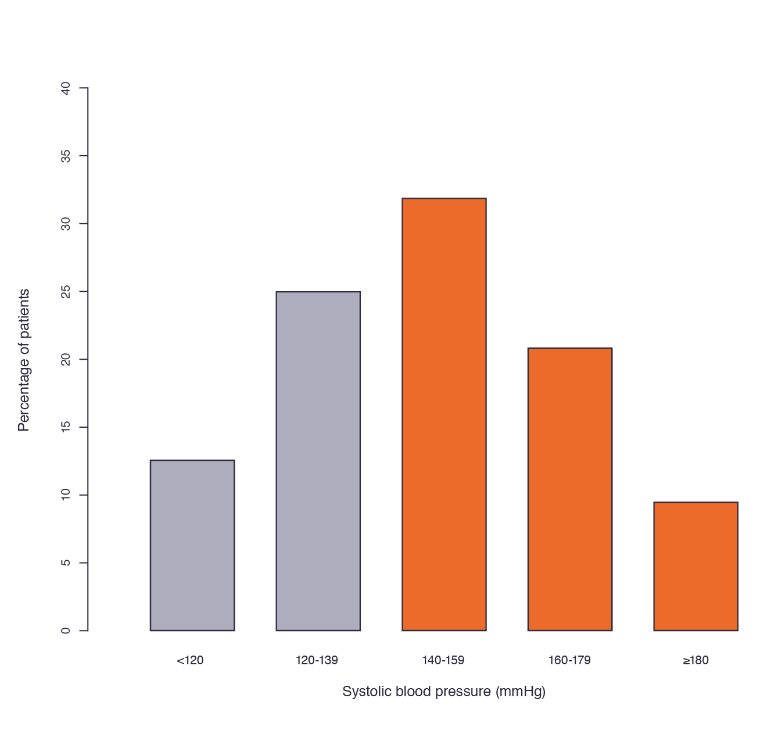
Despite substantial use of multiple antihypertensive agents, most hemodialysis patients have elevated pre-dialysis blood pressure.¹
Chapter 2, Figure 1:² Distribution of pre-dialysis systolic blood pressure in the Dialysis Outcomes and Practice Patterns Study Practice Monitor,
December 2015.¹
Over 60%
of conventional hemodialysis patients
>140 mmHg SBP
¹The DOPPS Practice Monitor. http://www.dopps.org/DPM/. Accessed May 20, 2015.
²Bakris GL, JM Burkhart, Weinhandl ED, McCullough PA, Kraus MA. Intensive Hemodialysis, Blood Pressure, and Antihypertensive Medication Use. Am J Kidney Dis. 2016;68(5)(suppl 1):S15-S23.
AdvancingDialysis.org

Slide 3
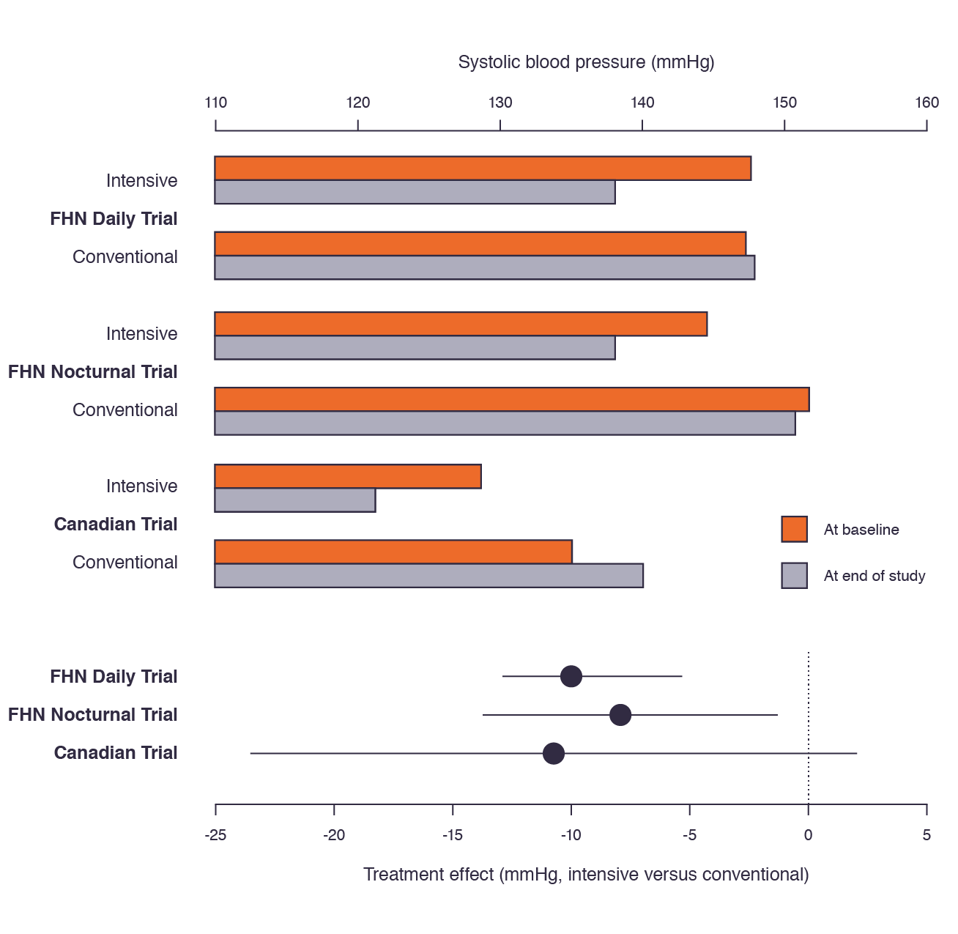
Multiple randomized clinical trials show intensive hemodialysis significantly lowers blood pressure.^{1,2,3}
Chapter 2, Figure 2:⁴ Effects of intensive versus conventional hemodialysis on pre-dialysis systolic blood pressure in the FHN Daily Trial,¹ the FHN Nocturnal Trial,² and the Canadian trial of nocturnal hemodialysis.³
Estimated treatment effects (solid dots) and associated 95% confidence intervals (solid lines) are displayed at the bottom.
¹FHN Trial Group, Chertow GM, Levin NW, et al. In-center hemodialysis six times per week versus three times per week. N Engl J Med. 2010;363(24):2287-2300. doi:10.1056/NEJMoa1001593. ²Rocco MV, Lockridge RS, Beck GJ, et al. The effects of frequent nocturnal home hemodialysis: the Frequent Hemodialysis Network Nocturnal Trial. Kidney Int. 2011;80(10):1080-1091. doi:10.1038/ki.2011.213. ³Culleton BF, Walsh M, Klarenbach SW, et al. Effect of frequent nocturnal hemodialysis vs conventional hemodialysis on left ventricular mass and quality of life: a randomized controlled trial. JAMA. 2007;298(11):1291-1299. doi:10.1001/jama.298.11.1291.
⁴Bakris, G.L., Burkart, J.M., Weinhandl, E.D., McCullough, P.A., Kraus, M.A. Intensive hemodialysis, blood pressure, and antihypertensive medication use. Am J Kidney Dis. 2016;68:S15–S23.
-10 mmHg
-8 mmHg
-11 mmHg
AdvancingDialysis.org

Slide 4
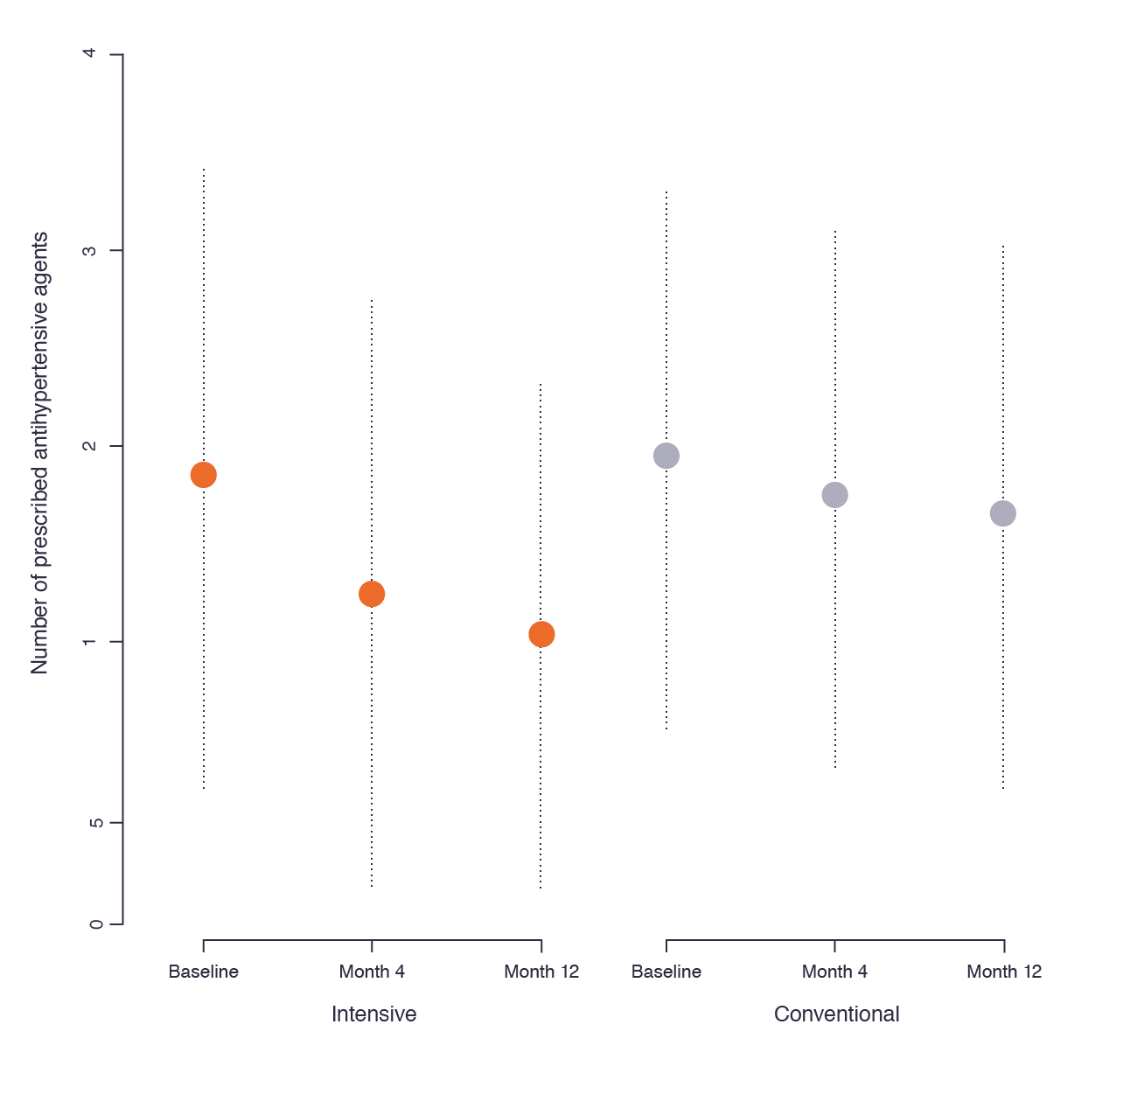
In the FHN Daily Trial, the number of antihypertensive medications per patient declined from 2.2 to 1.4.¹
In trials of nocturnal hemodialysis, the number of antihypertensive medications per patient decreased similarly.²
Chapter 2, Figure 3:³ Mean number of prescribed antihypertensive medications at baseline, at month 4, and at month 12 of the FHN Daily Trial.¹
Dashed bars span one standard deviation above and below the mean.
36% Decrease at month 12
¹Kotanko P, Garg AX, Depner T, et al. Effects of frequent hemodialysis on blood pressure: Results from the randomized frequent hemodialysis network trials. Hemodial Int Int Symp Home Hemodial. 2015;19(3):386-401. doi:10.1111/hdi.12255. ²Culleton BF, Walsh M, Klarenbach SW, et al. Effect of frequent nocturnal hemodialysis vs. conventional hemodialysis on left ventricular mass and quality of life: a randomized controlled trial. JAMA. 2007;298(11):1291-1299. doi:10.1001/jama.298.11.1291. ³Bakris, G.L., Burkart, J.M., Weinhandl, E.D., McCullough, P.A., Kraus, M.A. Intensive hemodialysis, blood pressure, and antihypertensive medication use. Am J Kidney Dis. 2016;68:S15–S23.
AdvancingDialysis.org

