Slide 1
Hypertension in Dialysis Patients
A consensus document by the EURECA-m working group of the ERA-EDTA and the Hypertension and the Kidney working group of the ESH
Journal of Hypertension. 2017 Apr; 35(4):657-676.
Notes:
New

Slide 2
Important information
All forms of hemodialysis, including treatments performed in-center and at home, involve some risks. When vascular access is exposed to more frequent use, infection of the site, and other access related complications may also be potential risks. In addition, there are certain risks unique to treatment in the home environment. Patients differ and not everyone will experience the reported benefits of more frequent hemodialysis.
Certain risks associated with hemodialysis treatment are increased when performing solo home hemodialysis because no one is present to help the patient respond to health emergencies.
Certain risks associated with hemodialysis treatment are increased when performing nocturnal therapy due to the length of treatment time and because therapy is performed while the patient and care partner are sleeping.
Notes:
Previously Approved (APM2540)
There are risks associated with all forms of dialysis, but one item to point out is that certain risks are unique to home as treatments are done without the presence of a medial professional.

Slide 3
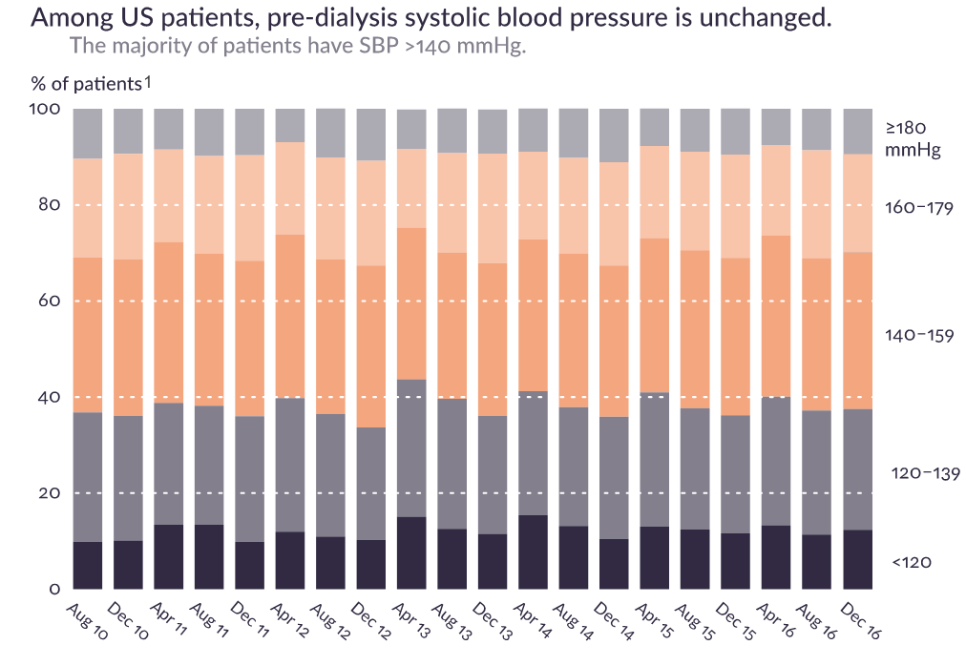
Background
Hypertension is common in dialysis patients¹
Elevated blood pressure, measured by ambulatory blood pressure monitoring, is clearly associated with shorter survival²⁻⁵
Appropriate treatment requires understanding of the principal causes of hypertension⁶
¹DOPPS http://www.dopps.org/DPM\
²Alborzi, P., Patel, N., and Agarwal, R. Home blood pressures are of greater prognostic value than hemodialysis unit recordings. Clin J Am Soc Nephrol. 2007; 2: 1228–1234.
³Agarwal, R. Blood pressure and mortality among hemodialysis patients. Hypertension. 2010; 55: 762–768.
⁴Agarwal, R. The controversies of diagnosing and treating hypertension among hemodialysis patients. Semin Dial. 2012; 25: 370–376.
⁵Agarwal, R. Pro: Ambulatory blood pressure should be used in all patients on hemodialysis. Nephrol Dial Transplant. 2015; 30: 1432–1437.
⁶Sarafidis PA, et al. Hypertension in dialysis patients. J Hypertens. 2017;35(4):657-676

Slide 4
Numerous Causes of Hypertension¹
Volume overload
Arterial stiffness increase
Sympathetic nervous system activation
Renin-angiotensin-aldosterone system activation
Endothelial dysfunction
Sleep apnea
Erythropoietin-stimulating agents
¹Sarafidis PA, et al. Hypertension in dialysis patients. J Hypertens. 2017;35(4):657-676
²DOPPS http://www.dopps.org/DPM\

Slide 5
Progressive Pathophysiology
Left ventricular hypertrophy
Heart failure
Cardiac arrhythmias
Sudden cardiac death
Uncontrolled hypertension¹
¹Zipes DP,‎ Libby P,‎ Bonow RO,‎ Mann DL,‎ Tomaselli GF. Braunwald’s Heart Disease: A Textbook of Cardiovascular Medicine. 11th ed. Elsevier; 2018.

Slide 6
No Recent Progress in Sudden Cardiac Death
One-year cardiovascular mortality rates in adult dialysis patients, by primary cause of death, according to the Death Notification form¹
Sudden cardiac death
Acute myocardial infarction
¹Wetmore JB, Gilbertson DT, Liu J, Collins AJ. Improving outcomes in patients receiving dialysis: The Peer Kidney Care Initiative, Clin J Am Soc Nephrol. 2016 Jul 7;11(7):1297-304. Figure 4.5.

Slide 7
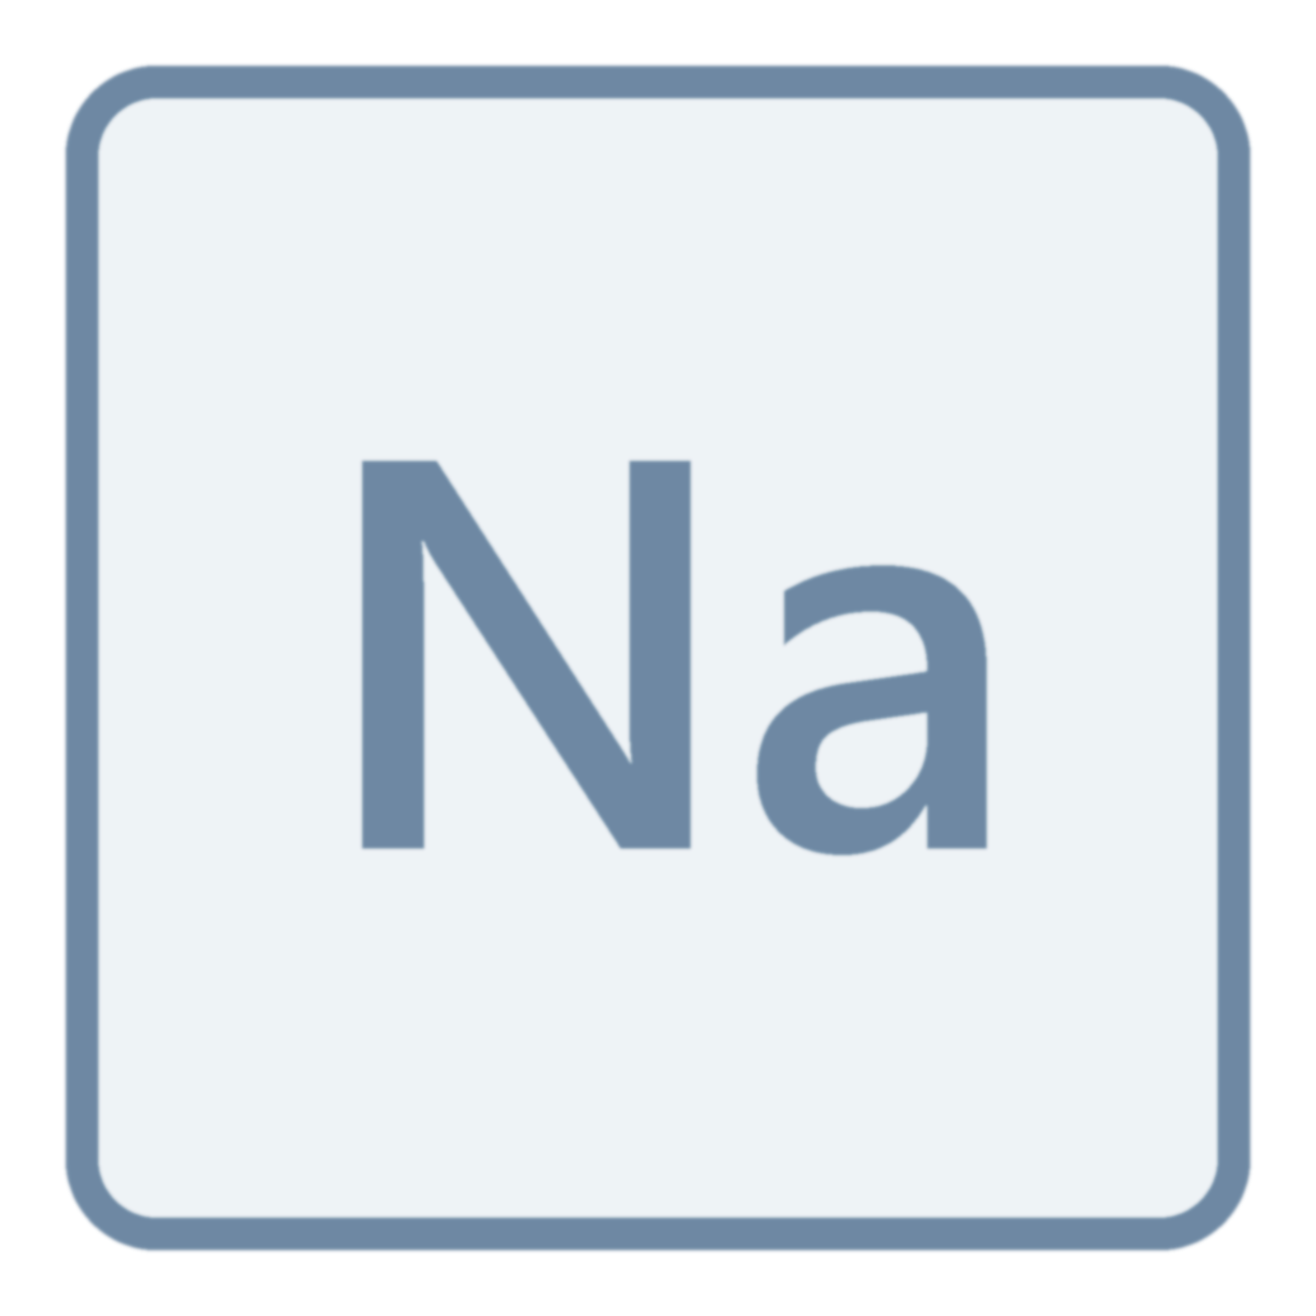
Bottom Line
+
Key Causes of Hypertension¹
“Sodium and volume excess appear to be the most important causes of hypertension in dialysis patients” ¹
¹Sarafidis PA, et al. Hypertension in dialysis patients. J Hypertens. 2017;35(4):657-676

Slide 8
Volume Overload
Even when residual renal function is preserved, sodium and fluid excretory capacity is substantially impaired
Sodium retention and volume overload is often not easily identifiable
ESRD patients have the highest sodium-sensitivity of blood pressure
Sodium retention may occur in the form of osmotically inactive sodium in the connective tissue and skin
Sarafidis PA, et al. Hypertension in dialysis patients. J Hypertens. 2017;35(4):657-676.

Slide 9
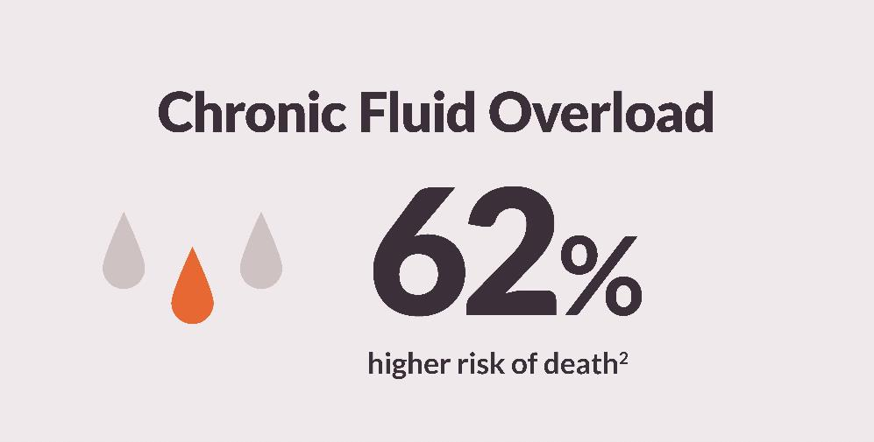
“Until fluid and sodium overload is removed during dialysis, a rise in peripheral vascular resistance will sustain hypertension in these individuals.”¹
¹Sarafidis PA, et al. Hypertension in dialysis patients. J Hypertens. 2017;35(4):657-676
²Zoccali C et al. Chronic fluid overload and mortality in ESRD. J Am Soc Nephrol. 2017 Aug;28(8):2491-2497.
Notes:
New with Previously Approved content (APM2920)

Slide 10
Challenges with Thrice-weekly Hemodialysis
Uncontrolled Hypertension
Left Ventricular Hypertrophy
Heart Failure
Hospitalizations and Death
Fluid Overload¹
High Ultrafiltration Rate
Intradialytic Hypotension
Cramping, Dizziness,
Nausea, etc.
“Early Sign-offs” and “No-Shows”
Cardiac &
organ system
Stunning
Long Post-Dialysis Recovery Time
Poor QOL
¹Rocco MV, Burkart JM. Prevalence of missed treatments and early sign-offs in hemodialysis patients. J Am Soc Nephrol. 1993 Nov;4(5):1178-83.
Notes:
Previously Reviewed (no comments, not approved in Agile)

Slide 11
Treatment Strategies¹
Non-pharmacological strategies
Pharmacological strategies
Management of hypertension in dialysis patients should focus at correction of the primary pathogenetic mechanisms, that is sodium and volume excess.
¹Sarafidis PA, et al. Hypertension in dialysis patients. J Hypertens. 2017;35(4):657-676.

Slide 12
Non-pharmacological Strategies to Reduce Blood Pressure
Reduce salt intake¹
Reducing the amount of sodium gained from diet or dialysate fluid is critical to achieve BP control
Dietary sodium restriction appears to be an effective approach to limit sense of thirst, reduce interdialytic weight gain and facilitate achievement of dry-weight and BP control
Reduce salt intake
Individualize dialysate sodium
Increase treatment length and frequency
¹Sarafidis PA, et al. Hypertension in dialysis patients. J Hypertens. 2017;35(4):657-676.

Slide 13
Non-pharmacological Strategies to Reduce Blood Pressure
Individualize dialysate sodium¹
Recent research has emphasized that a high-dialysate sodium concentration may increase thirst and interdialytic weight gain
A consensus document by the Chief Medical Officers of US Dialysis Providers warns against the use of dialysate with a sodium concentration exceeding predialysis serum sodium
Reduce salt intake
Individualize dialysate sodium
Increase treatment length and frequency
¹Sarafidis PA, et al. Hypertension in dialysis patients. J Hypertens. 2017;35(4):657-676.

Slide 14
Non-pharmacological Strategies to Reduce Blood Pressure
Increase treatment length and frequency¹
Length of dialysis session must not be decided only on the grounds of optimal Kt/V
Hemodialysis patients should receive at least 3 dialysis sessions of 4 hours each per week
Increasing duration of dialysis may represent an additional approach to control BP
Patients assigned to longer or more frequent dialysis regimens achieve better BP control with reduced requirements for antihypertensive medications
Reduce salt intake
Individualize dialysate sodium
Increase treatment length and frequency
¹Sarafidis PA, et al. Hypertension in dialysis patients. J Hypertens. 2017;35(4):657-676.

Slide 15
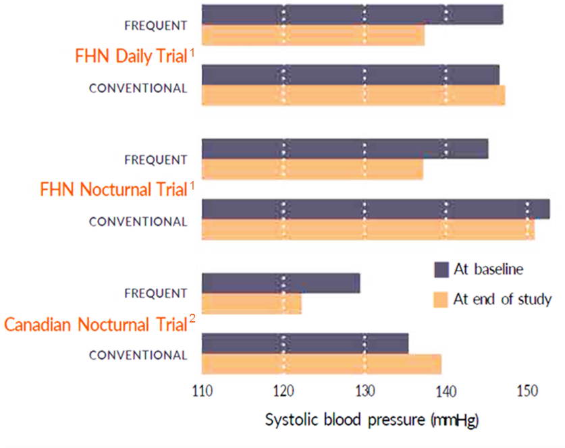
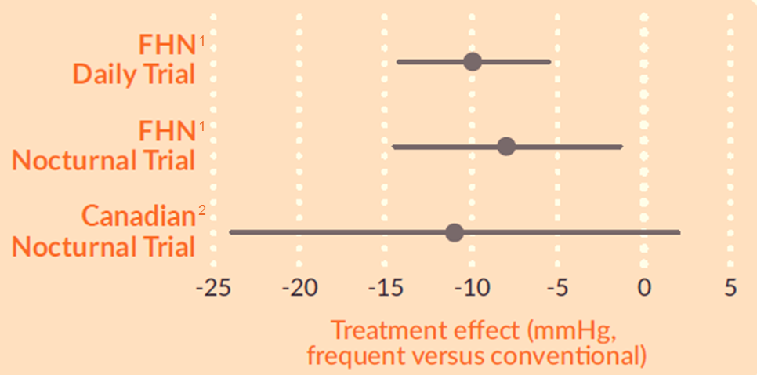
More Frequent Hemodialysis Reduces Blood Pressure
¹
¹
²
¹Kotanko P, Garg AX, Depner T., et al.; FHN Trial Group. Effects of frequent hemodialysis on blood pressure: Results from the randomized frequent hemodialysis network trials. Hemodial Int. 2015;19(3):386-401.
²Culleton BF, Walsh M, Klarenbach SW, et al. Effect of frequent nocturnal hemodialysis vs conventional hemodialysis on left ventricular mass and quality of life: a randomized controlled trial. JAMA. 2007;298(11):1291-9.

Slide 16
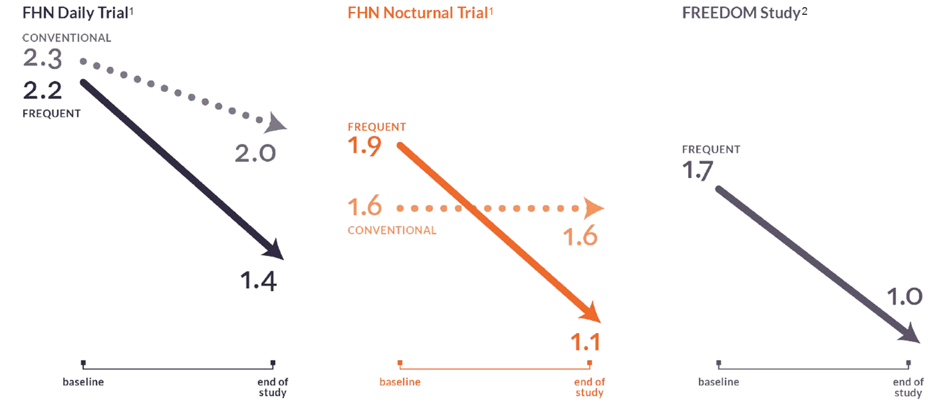
More Frequent Hemodialysis Reduced Need for Prescribed Antihypertensive Medication
¹Kotanko P, Garg AX, Depner T., et al.; FHN Trial Group. Effects of frequent hemodialysis on blood pressure: Results from the randomized frequent hemodialysis network trials. Hemodial Int. 2015;19(3):386-401.
²Jaber BL, Collins AJ, Finkelstein FO, et al. Daily hemodialysis reduces the need for anti-hypertensive medications. Abstract. Renal Week 2009, San Diego, CA.

Slide 17
Pharmacological Strategies¹
Beta blockers
Calcium channel blockers
ACE inhibitors & ARBs
Mineralocorticoid receptor antagonists
Administration of antihypertensive drug therapy in dialysis patients considered to be volume overloaded should follow the attainment of dry-weight.
¹Sarafidis PA, et al. Hypertension in dialysis patients. J Hypertens. 2017;35(4):657-676.

Slide 18
Key Takeaways
FINDING¹
Salt and water are foremost problems
Nonpharmacologic interventions targeting sodium and volume excess are fundamental—and should be carefully implemented before pharmacological interventions
RECOMMENDATION¹
Limit sodium exposure from diet or dialysate
Increase treatment length and frequency
¹Sarafidis PA, et al. Hypertension in dialysis patients. J Hypertens. 2017;35(4):657-676.

Slide 19
Broader context as summarized by Dr. Allan J. Collins:
Chief Medical Officer for NxStage Medical, Inc.
University of Minnesota School of Medicine
Persistent hypertension is found in more than half of the dialysis population, making it a fundamental and unmet challenge in dialysis
The link between hypertension, left ventricular hypertrophy, heart failure, and sudden death is clinically clear—effective interventions, however, have been lacking
Dietary control of salt intake is challenging to address, but also critical
More frequent HD has consistently been associated with significant improvement in BP control and regression of LVH
Additional research is needed to assess the impact of more frequent HD on sudden death
Dr. Collins has held several leadership roles at the National Kidney Foundation (NKF), serving as president for two years, and on the NKF scientific advisory board for six years, and with the Kidney Dialysis Outcomes Quality Initiative. Dr. Collins is the Chief Medical Officer for NxStage Medical, Inc.

Slide 20
About this presentation
This presentation is one in an ongoing series focused on recent articles, clinical findings or guidelines related to issues affecting dialysis patients.
AdvancingDialysis.org is dedicated to providing clinicians and patients with better access to and more awareness of the reported clinical benefits and improved quality of life made possible with home dialysis, including more frequent, solo, more intensive, and nocturnal therapy schedules.
For more information, visit AdvancingDialysis.org
AdvancingDialysis.org is a project of NxStage Medical, Inc.

Slide 21
www.AdvancingDialysis.org
© 2018 NxStage Medical, Inc.
Notes:
Changed color – APM2302

